Slide 1
The Contemporary Challenge of Maternal Mortality in the U.S.
Gene Declercq, PhD
Boston University School of Public Health
April, 2023
www.birthbythenumbers.org

Slide 2
Outline of the Presentation
Clarifying Definitions
Historical Context
The Strange Case of the Pregnancy Checkbox
The Pregnancy Mortality Surveillance System
Comparing the U.S. to the Rest of the World
The Persistence of Racial Disparities
Update on 2021-22 Data Release
7. Timing and Maternal Mortality a Public Health Problem
8. The Issue is Broader than Maternal Mortality
9. The Way Forward
www.birthbythenumbers.org
Notes:
This presentation will cover 9 different topics.

Slide 3
1. Definitions – the multiple measures of maternal death
www.birthbythenumbers.org
Notes:
Part of the current challenge in addressing the problem of maternal mortality are the multiple measures that are currently used. It’s not a question of correct or incorrect measures, but rather that they capture different elements the problem.

Slide 4
First a quick side trip into the terms rate and ratio. If you don’t find that discussion enthralling, you:
(a) are a normal human being; and
(b) can skip to slide 11 and wonder what you missed.
www.birthbythenumbers.org

Slide 5
Is Maternal Mortality a Ratio or a Rate?
WHO reports maternal mortality as a ratio, while the U.S. National Vital Statistics System reports maternal mortality as a rate. What’s the difference?
Maternal Mortality Ratio:
Deaths during pregnancy up to 42 days ppm Live Births
It is a ratio because all the cases in the numerator (e.g. death during early pregnancy) are not necessarily included in the denominator.
www.birthbythenumbers.org
Notes:
There is some disagreement in the literature as to whether maternal mortality should be reported as a rate or a ratio. WHO uses the term “ratio,” while the U.S. National Center for Health Statistics uses “rate.” The next two slides provide examples.

Slide 6
Source: Hoyert DL. Maternal mortality rates in the United States, 2021. NCHS Health E-Stats. 2023.
DOI: https://dx.doi.org/10.15620/cdc:124678
www.birthbythenumbers.org
Notes:
This is from a 2023 National Center for Health Statistics report on maternal mortality and notably refers to a mortality “rate.” It also displays the wide disparities in the U.S., a point we’ll explore in depth later.

Slide 7
Source: WHO (2023). Trends in maternal mortality 2000 to 2020.
www.birthbythenumbers.org
Notes:
This is from a WHO report on maternal mortality worldwide and clearly refers to a “ratio.” So what’s the difference?

Slide 8
Is Maternal Mortality a Ratio or a Rate?
Rate: # of events / total persons at risk in the population (usually % or number per 1,000/100,000)
Ratio: # of events (or persons) / some comparable cohort of people or events
www.birthbythenumbers.org
Notes:
There are the formal definitions of each measure.

Slide 9
Is Maternal Mortality a Ratio or a Rate?
RATE: The frequency of an event in a population. All the cases in the numerator are included in the denominator
Example: Births to women 15-19
Teen Birth Rate All women 15-19
RATIO: simply divides one number by another – all the cases in the numerator are not included in the denominator
Example: Maternal Deaths
Maternal Mortality Ratio Live Births
www.birthbythenumbers.org
Notes:
Teen births can be measured as a rate because all the cases in the numerator (births to 15-19 year olds) are included in the denominator (all females 15-19).
Since we use maternal deaths, which can occur during pregnancy, birth or postpartum as the numerator and live births as a denominator, we refer to a maternal mortality ratio. Why? Because there will be cases of maternal deaths (i.e. early in pregnancy) that don’t involve live births. For example, a Florida report found only 61% of all pregnancy associated deaths involved a live birth.

Slide 10
So, why do we use maternal mortality ratios internationally?
Because most countries don’t have clear measurement of the total number of pregnancies, but do have some
record of total births.
www.birthbythenumbers.org
Notes:
Actually, the U.S. and most industrialized countries also don’t have a rock-solid measure of total pregnancies either, but the U.S. NCHS has chosen to use the term rate apparently because of the public’s familiarity with it and to avoid the discussion we just had.

Slide 11
The three widely used definitions of maternal mortality:
1. Pregnancy associated death
2. Pregnancy related death
3 Maternal mortality
www.birthbythenumbers.org
Notes:
There are three similar but slightly different measures used in the reporting of maternal mortality and the next few slides explain the differences.

Slide 12
Three Definitions (in the U.S.)
Pregnancy Associated Death – The death of a women while pregnant or within one year of termination of pregnancy, irrespective of cause. (WHO calls these “pregnancy related”). Starting point for analyses.
Pregnancy Related Death – the death of a woman during pregnancy or within one year of the end of pregnancy from a pregnancy complication, a chain of events initiated by pregnancy, or the aggravation of an unrelated condition by the physiologic effects of pregnancy. Used by CDC for U.S. trends.
Maternal Mortality Ratio – the death of a woman while pregnant or within 42 days of termination of pregnancy, irrespective of the duration and site of the pregnancy, from any cause related to or aggravated by the pregnancy or its management but not from accidental or incidental causes. Typically reported as a ratio per 100,000 births. Used in international comparisons.
www.birthbythenumbers.org
Notes:
These are the three standard measures used in the U.S. Pregnancy associated deaths are the starting point since this captures all deaths of women who are pregnant or up to a year after the birth.
The measures of maternal mortality and pregnancy related deaths are very similar in that they take the pregnancy associated measure and add the component of having the cause of death related to the pregnancy. While there are some slight differences in how they get to that determination, the major distinction between those measures is temporal. The maternal mortality ratio includes deaths during pregnancy, at birth or up to 42 days after birth, while the pregnancy related mortality ratio extends the postpartum time period out to a year.

Slide 13
Pregnancy Associated Mortality
(1 year)
Pregnancy Associated Mortality:
All Deaths women of reprod. age
pregnancy to 1 year ppm
www.birthbythenumbers.org
Notes:
Pregnancy associated deaths are defined by timing – all deaths of women of reproductive age who had been pregnant up to a year prior to their deaths, regardless of the cause of the death. Therefore these include both deaths clearly the result of the pregnancy (e.g. because of a postpartum hemorrhage) and those that might have no relationship whatsoever (e.g. an automobile accident 6 months after the birth).
As an example, the Florida Pregnancy-Associated Mortality Review (PAMR) identified through a linkage of birth and death records, a total of 145 pregnancy associated deaths in 2014.
Source: L. Hernandez. Florida’s Pregnancy-Associated Mortality Review 2014 Update. Division of Community Health Promotion. Florida Department of Health.

Slide 14
Pregnancy Associated Mortality
(1 year)
Pregnancy Related Mortality:
All Deaths women of reprod. age
pregnancy to
1 year ppm Related to the pregnancy
Pregnancy Related Mortality
(1 year)
www.birthbythenumbers.org
Notes:
Pregnancy Related Deaths are the subset of those pregnancy associated deaths that are clearly linked to the pregnancy . In the Florida example, of the 145 pregnancy associated deaths they identified, the Pregnancy-Associated Mortality Review classified 35 (24.1%) as pregnancy related.

Slide 15
Pregnancy Associated Mortality
(1 year)
Maternal Mortality:
All Deaths women of reprod. age
pregnancy to 42 days ppm Related to the pregnancy
Pregnancy Related Mortality
(1 year)
Maternal Mortality (42 days)
www.birthbythenumbers.org
Notes:
The maternal mortality ratio is similar to the pregnancy related ratio, though instead of the time period being extended out to a year, it only counts death out to 42 days. It is an important measure since that the international standard and the basis for cross-national comparisons. Obviously with a shorter time frame, the maternal mortality ratio is inevitably going to be lower than the pregnancy related rate.

Slide 16
Pregnancy Associated Mortality
(1 year)
Pregnancy Associated Mortality: Deaths during pregnancy and up to 1 year postpartum
Pregnancy Related Mortality: Deaths during pregnancy and up to 1 year postpartum & related to the pregnancy
Pregnancy Related Mortality
(1 year)
Maternal Mortality (42 days)
Maternal Mortality: Deaths during pregnancy and up to 42 days postpartum & related to the pregnancy
www.birthbythenumbers.org
Notes:
For those of you who prefer everything on a single slide.

Slide 17
Timeline of Maternal Mortality Definitions
Week
after
Birth
Birth
42 days
PPM
Pregnancy
42 days PPM to 1 year
WHO Definition of Maternal Death
WHO Maternal Mortality
CDC Pregnancy Related
Pregnancy Associated
PPM – postpartum –period after the birth
www.birthbythenumbers.org
Notes:
Here’s the timeline of maternal death that illustrates how we measure it. Maternal mortality can involve deaths from the beginning of pregnancy up to one year after the end of the pregnancy.

Slide 18
Timing of Maternal Deaths (2017-19)
Source: Trost SL, Beauregard J, Njie F, et al. Pregnancy-Related Deaths: Data from Maternal Mortality Review Committees in 36 US States, 2017–2019. Atlanta, GA: Centers for Disease Control and Prevention, US Department of Health and Human Services; 2022.
www.birthbythenumbers.org
Notes:
This is a breakdown of deaths across the 21 month period from the beginning of pregnancy to a year postpartum. You can see that not all maternal deaths occur at the time of birth. More on this figure later.

Slide 19
Different Sources & Different Measures
U.S. National Vital Stat. System – Maternal Mortality
CDC Pregnancy Related Mortality System – Pregnancy Related Mortality
State Maternal Mortality Review Committees – Pregnancy Associated, Pregnancy Related & Maternal Mortality depending on states, but primarily Pregnancy Related Mortality
www.birthbythenumbers.org
Notes:
To further confuse matters, the U.S. now has three sources of maternal mortality data. The official rate, for international comparisons, is produced by the NVSS and has the advantage of timeliness. For example, the official 2021 maternal mortality ratio was published in March, 2023 – a relatively quick turnaround. The CDC’s system adds a layer of review (described later) that adds to the validity of their measure, but are published much later (the 2019 ratio was just released in March, 2023. Finally, as the number of state maternal mortality review committees increases the CDC has set up a system to gather comparable data from the committees to potentially allow for a national reporting of that data. The official description of each follows on the next slide.

Slide 20
US Maternal Mortality Surveillance
CDC – National Vital Statistics System (NVSS) | CDC – Pregnancy Mortality Surveillance System (PMSS) | State and Local Maternal Mortality Review Committees (MMRCs)
Data Source | Death certificates | Death certificates linked to fetal death and birth certificates | Death certificates linked to fetal death and birth certificates, medical records, social service records, autopsy, informant interviews, etc.
Time Frame | During pregnancy – 42 days | During pregnancy – 365 days | During pregnancy – 365 days
Source of Classification | ICD-10 codes | Medical epidemiologists | Multidisciplinary committees
Terms | Maternal death | Pregnancy associated, (Associated and) Pregnancy related, (Associated but) Not pregnancy related | Pregnancy associated, (Associated and) Pregnancy related, (Associated but) Not pregnancy related
Measure | Maternal Mortality Rate - # of Maternal Deaths per 100,000 live births | Pregnancy Related Mortality Ratio - # of Pregnancy Related Deaths per 100,000 live births | Pregnancy Related Mortality Ratio - # of Pregnancy Related Deaths per 100,000 live births
Purpose | Show national trends and provide a basis for international comparison | Analyze clinical factors associated with deaths, publish information that may lead to prevention strategies | Understand medical and non-medical contributors to deaths, prioritize interventions that effectively reduce maternal deaths
Reviewed in: Callaghan, William M. 2012. Overview of maternal mortality in the United States. Seminars in perinatology. 36; 1: 2-6. St. Pierre A, Zaharatos J, Goodman D, Callaghan WM. Challenges and opportunities in identifying, reviewing, and preventing maternal deaths. Obstet Gynecol. 2018;131(1):138–142.
Notes:
There are three main sources of maternal mortality data in the United States.
NCHS – CDC’s National Center for Health Statistics’ National Vital Statistics System (NVSS) reports the national maternal mortality rate: the number of maternal deaths per 100,000 live births. A maternal death is defined as a death while pregnant or within 42 days of the end of pregnancy, from any cause related to or aggravated by the pregnancy or its management, but not from accidental or incidental causes. This definition and timeframe are consistent with that used by the World Health Organization for reporting on maternal mortality rates. NVSS uses two pieces of information on the death record to identify maternal deaths — the pregnancy checkbox and the certified recording of the cause of death to assign maternal mortality ICD-10 codes. Identification of maternal deaths using automated processing of death records alone relies upon the death certifier accurately reporting causes of death related to pregnancy and pregnancy status.
PMSS – Like NVSS, PMSS uses vital records for identification of deaths, including descriptions of causes of death and pregnancy status information on death records. Different from NVSS, PMSS further uses linkages of death records of women of reproductive age to birth and fetal death records within 1 year of the death, media searches, and reporting from public health agencies, health care providers and the public in the identification process. PMSS uses a time frame that includes deaths during pregnancy through 1 year after the end of pregnancy; this timeline allows evaluation of all deaths which might be pregnancy-related. In PMSS, deaths are reviewed by medical epidemiologists who perform an in-depth review of vital records and other data as available (e.g., medical records, autopsy reports) for each death to determine the pregnancy-related mortality ratio. These linkage and review processes by PMSS result in slower reporting than NVSS, but a more rigorous identification of deaths related to pregnancy.
MMRCs – Maternal Mortality Review Committees (MMRCs) are multidisciplinary committees in states and cities that perform comprehensive reviews of deaths among women within a year of the end of a pregnancy. Similar to PMSS, MMRCs use multiple methods for comprehensive identification of deaths during pregnancy or within 1 year of the end of pregnancy, including linkages of death records of women of reproductive age to birth and fetal death records within 1 year of the death, media searches, and reporting from public health agencies, health care providers and the public. MMRCs have access to multiple sources of information that can provide a deeper understanding of the circumstances surrounding a death than PMSS is able.

Slide 21
Notes:
These illustrate the variation in how maternal deaths get reported in the US. For media and interested parties, it is critical to clearly identify which measure a report is using because they convey different messages.

Slide 22
Illustrating the Differences in Measures of Maternal Death: Same State; Same Years; 4 different results.
Pregnancy Associated Mortality
(1 year)
91.7
Pregnancy Related Mortality
(1 year)
27.8
NOTE: NVSS Data on Tenn. Maternal Mortality for 2017-2019:
75 Deaths; 242,217 births
Rate – 31.0/100,000
Maternal
Mortality
(42 days)
18.6
Tennessee Mortality Rates from the
Tenn. Maternal Mortality Review
Committee per 100,000 live births, 2017-19
www.birthbythenumbers.org
Notes:
None of these are wrong – they just measure different things. Pregnancy Associated Mortality will inevitably be the largest figure of the three since it encompasses all deaths to pregnant women out to a year postpartum, regardless of whether the pregnancy caused the death or not. The maternal mortality ratio is similar to the pregnancy related ratio, though instead of the time period being extended out to a year, it only counts death out to 42 days. Maternal mortality is an important measure since that the international standard and the basis for cross-national comparisons. Obviously with a shorter time frame, the maternal mortality ratio is inevitably going to be lower than the pregnancy related rate.

Slide 23
2. The Historical Trend in U.S. Maternal Mortality
www.birthbythenumbers.org
Notes:
How did we get to where we are now? The quality of data has evolved considerably over the years, but there’s two clear themes – the U.S. has: (a) not done well compared to other countries; and (b) has had a consistent problem with racial disparities.

Slide 24
Declaring Premature Victory
“An examination of the rates for the different states indicates areas in which further improvement can be expected, but it is clear that maternal mortality is no longer a nationwide problem……Childbearing has been made quite safe.”
Maternal Deaths One in a Thousand. JAMA, 1950; 144: 1096-7.
At the time the maternal mortality rate was 100 per 100,000
www.birthbythenumbers.org

Slide 25
U.S. Maternal Mortality (per 100,000 births), 1915-2021
Sources: NCHS. Maternal Mortality and Related Concepts. Vital & Health Statistics. Series 33; #3. & annual data reports. 1915-1960 data from NCHS. Vital Statistics Rates In The United States 1940-1960. NOTE: Shifts in measurement (e.g. not all states were part of registration system prior to 1933) accounts for some of the variation over time. 2007-2016 based on 2 year estimates of the pregnancy related mortality rate: Petersen E. MMWR.9/6/19; 2017: Rossen. Impact of Pregnancy Checkbox, U.S. 1999-2017.NCHS.VitalHlthStat.3(44);2020.; 2018: U.S. Hoyert DL Health E-Stat.Hyattsville, MD: NCHS. 2/2022.
www.birthbythenumbers.org
Notes:
As you can see from the endless footnote, there are multiple data sources here. The U.S. started recording maternal deaths as far back as 1915. The first attempts at national estimates involved those states that were voluntarily part of a national registry system. Part of the reason for the wide fluctuations before 1933 was that the national estimates involved different states as seen on the next slide. By 1933, all 48 states were part of the reporting system. The scale of this figure makes it appear the current rate is almost negligible…it’s not, as subsequent figures will illustrate.

Slide 26
Year State was Added to the Maternal Death Registry
www.birthbythenumbers.org
Notes:
Notably the addition of states to the registry wasn’t random, but rather involved initially Northern and Midwestern states with most Southern states joining after 1915. The last of the original 48 states to join was Texas in 1933

Slide 27
Number of U.S. Hospital Beds and Maternal Mortality, 1918-1950
Hospital Beds
Sources: Hospital beds- Statistical Abstract & JAMA: Maternal mortality - NCHS. Vital Statistics Rates In The U..S. 1940-1960.
www.birthbythenumbers.org
Notes:
A factor influencing the decline in maternal deaths was simply the growth in hospitals over time and the increasing number of births in hospitals, though keep in mind that: (a) access wasn’t distributed equitably; and (b) that’s not an indictment of contemporary home birth – both subjects of our presentation on home birth on the birthbythenumbers.org website.

Slide 28
U.S. Maternal Mortality (per 100,000 live births), 1951-2007
1951-1982
89% decline (75.0 to 7.9)
Source: NCHS. Deaths: Final Data. Annual Reports.
www.birthbythenumbers.org
Notes:
Looking at the entire 100 year pattern makes recent trends hard to distinguish, so the next 4 slides will involve the period from 1951 to the present. This trend can be divided into 3 somewhat distinct segments. This presents the first with a substantial (89%) decline from 1951 until the early 1980s.

Slide 29
U.S. Maternal Mortality (per 100,000 live births), 1951-2007
1982-1998
Basically no change
7.9 to 7.1
Source: NCHS. Deaths: Final Data. Annual Reports.
www.birthbythenumbers.org
Notes:
From the early 1980s until the turn of the century the ratio remained essentially flat.

Slide 30
U.S. Maternal Mortality (per 100,000 live births), 1951-2007
1997-2007
78% increase (7.1 to 12.7)
Source: NCHS. Deaths: Final Data. Annual Reports.
www.birthbythenumbers.org
Notes:
From the late 1990s to 2007, the maternal mortality ratio actually rose. As WHO has pointed out, since 2000, only two countries – the U.S. and Dominican Republic – have experienced a clear rise in their maternal mortality.

Slide 31
U.S. Maternal Mortality Ratio (per 100,000 live births) , 1951-2007
Why did reporting of an official maternal
mortality ratio for U.S. stop in 2007?
Source: NCHS. Deaths: Final Data. Annual Reports.
www.birthbythenumbers.org
Notes:
The explanation for why the U.S. stopped reporting an official figure for maternal mortality is a somewhat complex one and the subject of section 3.

Slide 32
Last reporting (2007)of a maternal mortality rate by NCHS before 2018
www.birthbythenumbers.org
Notes:
This is from the report (2007 Deaths, Final Data) that was the last time until 2018 that the U.S. reported an official maternal mortality rate. Note at the time that the black/white disparity was 2.7 (28.4 to 10.5) and that the Hispanic rate was lower than the non-Hispanic white rate was.

Slide 33
How did the U.S. get to the point where they stopped publishing a maternal mortality rate?
Efforts to avoid poor case ascertainment led to over-ascertainment
www.birthbythenumbers.org

Slide 34
3. The Case of the Pregnancy Checkbox
“This difficulty [in measuring maternal mortality] would be solved easily if universal birth and stillbirth registration was practiced and if death certificates required a statement as to the association of the puerperal state.”
www.birthbythenumbers.org

Slide 35
3. The Case of the Pregnancy Checkbox
“This difficulty [in measuring maternal mortality] would be solved easily if universal birth and stillbirth registration was practiced and if death certificates required a statement as to the association of the puerperal state.”
Committee on Maternal Welfare. Maternal Mortality in Philadelphia 1931-1933 (1934)
www.birthbythenumbers.org
Notes:
Clearly the problem of measuring maternal mortality is hardly new and neither is the idea of a pregnancy checkbox on death certificates.

Slide 36
Quick note on the federal reporting system of births and deaths.
There is no centralized “national” reporting system in the U.S.
Birth and death data is collected at the local level, compiled at the state level, and then selected items are sent to the National Vital Statistics System (NVSS).
The states and the NVSS periodically negotiate an agreement (seen in the U.S. Standard Certificate of Death) on the specific items from state data collection used in the national file. These revisions were last made in 1975,1989, and 2003.
The failure to officially report U.S. maternal deaths from 2008-18 was a direct result of the 2003 revisions that attempted to improve reporting.
www.birthbythenumbers.org
Notes:
The failure to report a maternal mortality rate for a decade (2008-2017) was a classic case of unintended consequences associated with a reform.

Slide 37
Am J Prev Med 2000;19(1S):35-39.
16 States already had a pregnancy checkbox on death certificates as far back as 1991-1992, but with different wording
www.birthbythenumbers.org
Notes:
The difficulty starts in the 1990s as those responsible for measuring maternal mortality are concerned that they are undercounting an entire class of maternal deaths – those that occur during pregnancy. It’s a reasonable assumption since a woman who might die early in her pregnancy might easily not be included in a state’s count of maternal deaths. The proposed solution? How about adding a box to death certificates that specifically asks about pregnancy status of the deceased woman? By the late 1990s 16 states had included some kind of pregnancy checkbox to their death certificates, though they took multiple forms.

Slide 38
Wording of “Pregnancy Checkbox” in states prior to 2003
State | Wording
Alabama | Was there a pregnancy in last 42 days? (Specify Yes, No, or dk.)
California | If female, pregnant in last year? □ Yes □ No □ UNK
Florida | If female, was there a pregnancy in the past 3 months? Yes No
Idaho | If female aged 0–54: □ not preg win past yr □ preg at time of death □ not pregnant, but preg within 42 days of death □ not pregnant but preg 43 days to 1 yr before death □ unknown if preg w/in the past yr
Illinois | If female, was there a pregnancy in past three months? Yes □ No □
Indiana | Was decedent pregnant or 90 days postpartum? (Yes or no)
Iowa | If female, was there a pregnancy in the past 12 months? (Specify yes or no)
Kentucky | If female, was there a pregnancy in the past 12 months? □ Yes □ No
Louisiana | If deceased was female 10–49, was she pregnant in the last 90 days? □ Yes □ No □ Unk
Maryland | If female: Was decedent pregnant in the past 12 months? □ Yes □ No □ Unknown Separate field on dates of death and delivery support capability to compute the other categories in the standard.
Minnesota | Was female pregnant: At death? yes no In last 12 months? yes no unknown
Mississippi | Had decedent been pregnant within 90 days prior to death? □ Yes □ No
Missouri | If deceased was female 10–49, was she pregnant in the last 90 days? □ Yes □ No □ Un
Montana | If female: □ not preg within past year □ not preg but preg within 42 days of death □ not preg but pregnant 43 days to 1 year before death □ pregnant at time of death □ unknown if preg within past year
New Jersey | If female, was she pregnant at death, or any time 90 days prior to death □ Yes □ No
New Mexico | Was decedent pregnant within last 6 weeks? □ Yes □ No
North Dakota | Was deceased pregnant within 18 months of death? □ Yes □ No
Nebraska | If female, was there a pregnancy in the past 3 months? Yes □ No □
Texas | Was decedent pregnant at time of death □ yes □ no □ UNK within last 12 MO □ yes □ no □ UN
Virginia | If female, was there a pregnancy in past 3 months? Yes □ No □ Unknown □
Time periods used:
42 days;
6 weeks;
3 months;
90 days;
12 mos;
“last year”
Source: Hoyert DL, NVSR; vol 69 no 1. Hyattsville, MD: NCHS. 2020.
www.birthbythenumbers.org
Notes:
These are just some of the examples of the different ways states asked the question on their death certificates. This variance led to calls to standardize the process across states with the change proposed to be implemented in the 2003 revision.

Slide 39
Revised (2003) U.S. Standard
Certificate of Death
www.birthbythenumbers.org
Notes:
The box highlighted in red identifies the placement of the pregnancy checkbox on the death certificate. I know it’s too small to read – see next slide.

Slide 40
To improve case identification:
U.S. Standard Pregnancy Question, 2003 (sort of)
Checkbox format:
IF FEMALE:
Not pregnant within past year
Pregnant at time of death
Not pregnant, but pregnant within 42 days of death
Not pregnant, but pregnant 43 days to 1 year before death
Unknown if pregnant within the past year
Meant to solve 2 problems:
Most states had no such question; and
Different questions used in different states that did ask about pregnancy status.
www.birthbythenumbers.org
Notes:
This is the exact form of the questions posed. As noted, this change was intended to standardize the question across all state death certificates that already had a question and to fill in those states that did not yet have the question.

Slide 41
Delays in Adoption of the U.S. Standard Pregnancy Question among States
 | New Adopters* | Total
2003 | 4 | 4
2004 | 7 | 11
2005 | 7 | 18
2006 | 4 | 22
2007 | 2 | 24
2008 | 7 | 31
2009 | 0 | 31
2010 | 4 | 35
2011 | 2 | 37
2012 | 4 | 41
2013 | 1 | 42
2014 | 5 | 47
2015 | 2 | 49
2016 | 1 | 50
2017 | 1 | 51
State | Year Adopted
CA, ID, MT, NY | 2003
New Jersey | 2004
Florida | 2005
Texas | 2006
Ohio | 2007
Massachusetts | 9/2014
Alabama | 2016
W. VA | 2017
* Note: Some states adopted change in the middle of the calendar year.
www.birthbythenumbers.org
Notes:
Here’s the catch. When making the changes that were part of the revisions in 1975 and 1989, implementing the process basically involved printing new forms and training staff in how to use them. The process might take only a year or two for all states to implement. In 2003 however, implementing the changes meant reprogramming electronic data systems. Stories differ, but it appears the state officials thought the feds would pay for the programming changes and when that didn’t happen, state adoption proceeded very gradually as these data and the map on the next slide illustrate.
Notably, by 2007, 23 states & D.C. had adopted the revised death certificate and the remaining 27 states had not. The problem was that those states that had adopted the new certificate were reporting higher rates than those who had not as seen in the slide after the map.

Slide 42
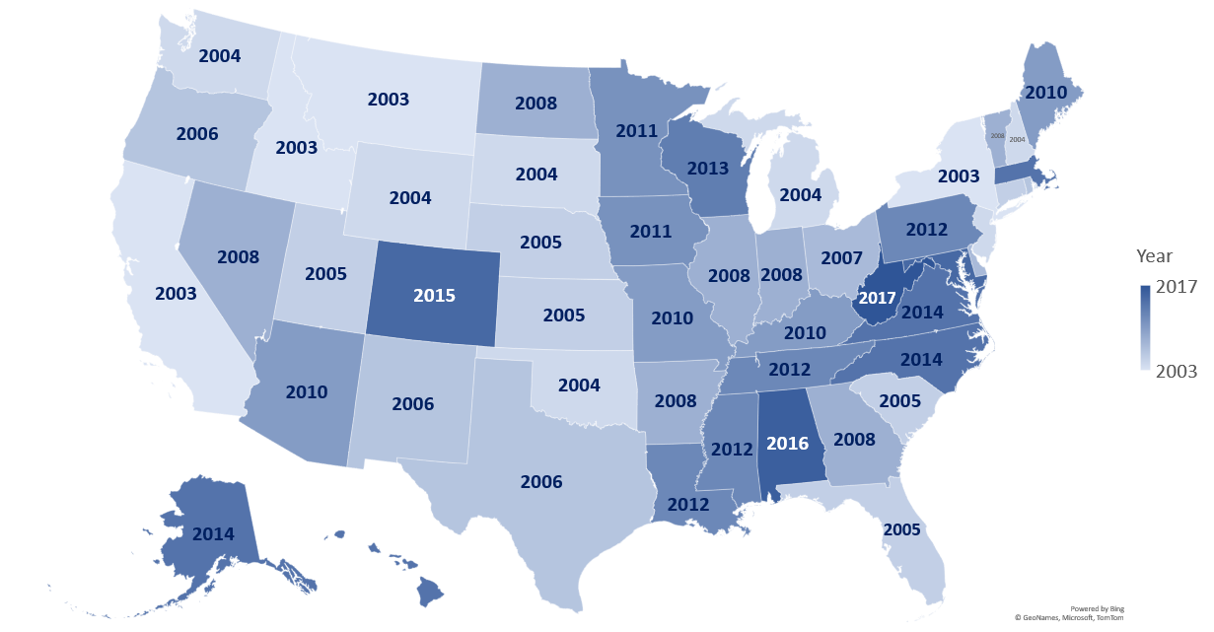
Staggered adoption of 2003 revisions by states (2003-17)
NH – 2004
VT – 2008
MA – 2014
CT – 2005
RI – 2006
NJ – 2004
DE – 2007
MD – 2015
*Until August 2021, California used a non-standard pregnancy checkbox
(only captured within 1 year)
2014
Notes:
The first challenge was the Staggered adoption of the revised 2003 death certificate by states
It took 14 years for all states to adopt the revised 2003 death certificate
And happy to talk about why this was in the Q&A, but just to note it was a long time
And California, although revised, did not include the standard checkbox in their revision

Slide 43
Maternal Mortality Rates (per 100,000) in States with & without a checkbox, 1996-2003
So adopting the checkbox will solve the problem of under ascertainment
& we can report a more accurate national rate after 2003?
Source: Hoyert DL. Maternal mortality and related concepts. National Center for Health Statistics. Vital Health Stat 3(33). 2007.
www.birthbythenumbers.org
Notes:
In an earlier study, researchers found significantly higher rates for states after they had revised their death certificates, including the new pregnancy checkbox.

Slide 44
www.birthbythenumbers.org
Notes:
This national study attempted to estimate a national maternal mortality rate by examining the impact of adding the checkbox by comparing mortality rates before and after the adoption of the checkbox.

Slide 45
Correcting for Impact of Adding Pregnancy Box
Also did tests involving 1 year and 3 year periods with little change
www.birthbythenumbers.org
Notes:
This was the simple formula we used for the comparison.

Slide 46
States that had no question & added the checkbox
Correction Factor: 1.93
Impact of adding the pregnancy checkbox was to approximately double a state’s maternal mortality ratio
Note: Includes 24 states that did not have a pregnancy question on their unrevised death certificate and which adopted the U.S. standard question upon revision: Arkansas, Arizona, Connecticut, Delaware, Georgia, Idaho, Kansas, Maine, Michigan, Montana, New Hampshire, Nevada, Ohio, Oklahoma, Oregon, Pennsylvania, Rhode Island, South Carolina, South Dakota, Tennessee, Utah, Vermont, Washington, and Wyoming.
www.birthbythenumbers.org
Notes:
The formal analysis found that in the 2 years after the adoption of the checkbox a state’s maternal mortality ratio almost doubled.

Slide 47
NVSS analyses of the impact of the pregnancy checkbox
www.birthbythenumbers.org
Notes:
With the release of the 2018 U.S. maternal mortality ratio, the National Center for Health Statistics released the first official ratio in 11 years and multiple methodological studies of the measurement of maternal mortality.

Slide 48
Statistical Analysis
Objective 1: Quantify the impact of the staggered implementation of the pregnancy checkbox on Maternal Mortality Rates (MMRs)
Objective 2: Estimate trends in MMRs from 1999 through 2017, accounting for the checkbox
Objective 3: Examine the impact of potential misclassification of pregnancy status on the death certificate on MMR trends from 1999 through 2017
www.birthbythenumbers.org
Notes:
These were the goals of the NCHS analysis.

Slide 49
NCHS Analysis of the Impact of Checkbox
Source: Rossen LM, etal. The impact of the pregnancy checkbox, 1999–2017. NCHS. Vital Health Stat 3(44). 2020.
www.birthbythenumbers.org
Notes:
This is similar to the analysis we had done – only they had a richer dataset and more resources with which to analyze it (we did our study without any funding). Once again, in the years after the checkbox is adopted, the maternal mortality ratio – in the same states – almost doubles.

Slide 50
Average % change in maternal mortality rates associated with the pregnancy checkbox implementation, by state of occurrence: U. S., 2003–17
Source: Rossen LM, etal. The impact of the pregnancy checkbox, 1999–2017. NCHS. Vital Health Stat 3(44). 2020.
www.birthbythenumbers.org
Notes:
This presents the average percent change by state. In 43 states and D.C. the ratio increased, ranging from a decrease of 10 per 100,000 in Mississippi to an increase of 84 per 100K in Wyoming.

Slide 51
Observed and predicted maternal mortality ratios: United States, 1999–2017
Per 100,000 births
Maternal Mortality Ratio
Without Checkbox
States with Checkbox
4 | 11 | 18 | 22 | 24 | 31 | 31 | 35 | 37 | 41 | 42 | 47 | 49 | 50 | 51
2003 | 2004 | 2005 | 2006 | 2007 | 2008 | 2009 | 2010 | 2011 | 2012 | 2013 | 2014 | 2015 | 2016 | 2017
Source: Rossen LM, etal. The impact of the pregnancy checkbox, 1999–2017. NCHS. Vital Health Stat 3(44). 2020.
www.birthbythenumbers.org
Notes:
This analysis presents what the national rates would be if all the states used the checkbox (blue line) and if none of the states used the checkbox (red line). The rise in the overall estimated rate reflects the growth in the number states using the revised death certificates (see Table) and hence reporting higher rates.
There's another important implication of this figure – it shows little change in the MMR, but assuming the checkbox had been universally adopted in 2003, the rate would have been flat only because the earlier rate was so high.

Slide 52
Ratio of pregnancy associated deaths assigned using the checkbox item to maternal deaths assigned without using the checkbox item for maternal deaths: Selected states, 2015–2016
 | Number of deaths
State | Assigned by checkbox | Assigned w/out checkbox | Ratio
47 States & D.C.* | 1,527 | 498 | 3.07
Florida | 78 | 37 | 2.11
Georgia | 134 | 28 | 4.79
Illinois | 40 | 21 | 1.90
New York | 72 | 41 | 1.76
Ohio | 53 | 24 | 2.21
Texas | 264 | 58 | 4.55
* Excludes Alabama, California, & W. Virginia
Source: Hoyert Dlet al. Evaluation of the pregnancy status checkbox on identification of maternal deaths. Nat’l Vital Stat Rep; V 69 # 1. Hyattsville, MD: NCHS. 2020.
www.birthbythenumbers.org
Notes:
This is a summary table from one of the evaluations of the checkbox. Overall the checkbox identified 3.1 times as many maternal deaths as they discovered based on the death records without the checkbox, although the magnitude of difference varied by state. NOTE: these are pregnancy associated deaths – whether they were pregnancy related hadn’t yet been determined, but the use of the checkbox substantially increases the base of potential pregnancy related deaths states were working with.

Slide 53
Two key problems raised by the checkbox
1. Over ascertainment
2 Loss of precision in identifying causes of maternal death – the rise of “other” causes.
www.birthbythenumbers.org
Notes:
We’ve just described the issue of over ascertainment of deaths. Now let’s examine the major consequence associated with having over counted maternal deaths – not knowing what causes to ascribe to those deaths.

Slide 54
The problem with “other”
Obstet Gynecol 2017;129:811–8
Source: MacDormanM. Trends in Mat. Mort. By Socioeconomic Characteristics. OBGYN.2017;129:811
www.birthbythenumbers.org
Notes:
We conducted a study to look at SES breakdowns, but as part of the analysis we discovered a serious problem with the classifications of death.

Slide 55
Maternal Death ICD-10 Codes
Underlying cause of death
Total maternal deaths (during pregnancy or within 42 days after the end of pregnancy) (A34, O00-O95, O98-O99)
Total direct obstetric causes (A34, O00-O92)
Pregnancy with abortive outcome (O00-O07)
Ectopic pregnancy (O00)
Hypertensive disorders (O10-O16)
Pre-existing hypertension (O10)
Eclampsia and pre-eclampsia (O11,O13-O16)
Obstetric Hemorrhage (O20,O43.2,O44-O46,O67,O71.0-O71.1, O71.3-O71.4,O71.7,O72)
Pregnancy-related infection (O23,O41.1,O75.3,O85,O86,O91)
Puerperal sepsis (O85)
Other obstetric complications (O21-O22,O24-O28,O30-O41.0, O41.8-O43.1, O43.8-O43.9,O47--O66,O68-O70,O71.2, O71.5, O71.6, O71.8, O71.9,O73,O75.0-O75.2,O75.4-O75.9,O87-O90,O92)
Diabetes mellitus in pregnancy (O24)
Liver disorders in pregnancy (O26.6)
Other specified pregnancy-related conditions (O26.8)
Obstetric embolism (O88)
Cardiomyopathy in the puerperium (O90.3)
Anesthesia-related complications (O29,O74,O89)
Total indirect causes (O98-O99)
Mental disorders and diseases of the nervous system (O99.3)
Diseases of the circulatory system (O99.4)
Diseases of the respiratory system (O99.5)
Other specified diseases and conditions (O99.8)
Obstetric death of unspecified cause (O95)
Late maternal causes (43 days-1 year after the end of pregnancy) (O96-O97)
Source: MacDormanM. OBGYN.2017;129:811
www.birthbythenumbers.org
Notes:
These are the standard causes of maternal deaths. Most are specific (e.g. eclampsia) but as you can see there are 4 which involve less-specific classifications. They are highlighted on the next slide.

Slide 56
Over Ascertainment??
Research into the cause of death category finds much of the increase is coming from less specific ICD-10 codes:
Other specified pregnancy-related conditions (O26.8)
Other obstetric complications (O21–O22, O24– O41.0, O41.8–O43.1, O43.8–O43.9,O47–O66, O68–O70, O71.2, O71.5,O71.6, O71.8, O71.9, O73–O75.2,O75.4–O75.9, O87–O90, O92)
Other specified diseases and conditions (O99.8)
Obstetric death of unspecified cause (O95)
Source: MacDormanM. OBGYN.2017;129:811
www.birthbythenumbers.org
Notes:
What we found was that a majority of the increase in maternal mortality was the result of increases in these less specific categories.

Slide 57
Impact of ill-defined causes on maternal deaths by cause of death, 27 states & DC, 2008-2009 to 2013-2014
 | 2008-9 | 2013-14 | % Change
Underlying Cause of Death | Rate | Rate | 2008/2009-2013/2014
Total Maternal | 20.6 | 25.4 | 23.3
Ill-defined ”other” causes | 7.0 | 10.4 | 47.9
Total maternal minus ill defined | 13.5 | 15.0 | 10.6
Total Direct Obstetric | 13.9 | 16.6 | 19.7
Other spec. pregnancy related cond. | 3.4 | 5.9 | 73.0
Total direct obstetric minus ill defined | 10.5 | 10.7 | 2.3
Total indirect causes | 5.3 | 8.2 | 54.4
Other specified dis. & conditions | 2.2 | 3.9 | 75.9
Total indirect minus ill defined | 3.1 | 4.3 | 38.7
Source: MacDormanM. OBGYN.2017;129:811
www.birthbythenumbers.org
Notes:
In this study of 27 states and D.C. we compared rates in the first 2 year period (2008-2009) to the second (2013-2014) by cause of death. The figures in the right column are the % changes over time. The percentages in blue are the overall changes, those in black are the increases from ill-defined (“other”) causes and those in red represent the increase when ill defined cases are removed. A 23% overall increase becomes only 11% when the “other” causes are removed (notably an 11% increase is still a sizable increase). In the case of direct obstetric causes, an overall 20% increase drops to 2% when ill defined causes are removed. The point is that a significant proportion of the increase, potentially associated with false positives from the adoption of the checkbox, was coming from ill-defined causes of death.

Slide 58
Ratios of deaths classified using pregnancy status checkbox to those classified without using the checkbox by Cause of Death, 47 states & D.C., 2015–2016
Source: Hoyert DL, etal. Evaluation of the pregnancy status checkbox on the identification of maternal deaths. NVSR; vol 69 no 1. Hyattsville, MD: NCHS. 2020.
www.birthbythenumbers.org
Notes:
This is from one of the evaluations released with the 2018 U.S. ratio. The numbers in green represent the ratio of maternal deaths identified from the checkbox to those without the checkbox by specific causes of death. Obviously, the greatest distinctions are among the “other” causes of death.

Slide 59
Number of births and deaths with positive pregnancy responses in the checkbox: United States, 2013
Age | Births | Deaths
40-44 | 134,540 | 145
45-49 | 10,329 | 89
50-54 | 780 | 148
55-59 | 74 | 33
60-64 | 7 | 51
65-69 |  | 45
70-74 |  | 51
75-79 |  | 46
80-84 |  | 42
85+ |  | 147
331 cases of positive pregnancy checkbox in deaths of women 65+
NOTE: Alabama, Alaska, Colorado, Hawaii, Massachusetts, North Carolina, Virginia, and West Virginia did not have the standard checkbox in 2013.
Source: Hoyert & Miniño. Maternal mortality in the United States, 2018. NVSR; vol 69 no 2. Hyattsville, MD: NCHS. 2020
www.birthbythenumbers.org
Notes:
Once again, the Hoyert led evaluation provides more conclusive evidence of the false positives with hundreds of cases of the pregnancy checkbox being checked for women who are not of reproductive age as this table illustrates.

Slide 60
Over-ascertainment: Results of a 4 state study (Georgia, Louisiana, Michigan, and Ohio)
In 28% of cases with pregnancy checkbox checked, reviewers were not certain the woman was pregnant
Source: A. Daymude. Checking the pregnancy checkbox: Evaluation of a four‐state quality assurance pilot. Birth 2019 online & Catalano A. Validity of the Pregnancy Checkbox. AJOG.2019.online.
www.birthbythenumbers.org
Notes:
In a 4 state study in which every case was carefully reviewed, in 28% of the death records they studied, they could not be certain that the deceased had been pregnant and in 3/4ths of those cases it was clear the deceased was not pregnant.

Slide 61
False Positives on the Pregnancy Checkbox by Age
Source: Adapted from Catalano A. Validity of the Pregnancy Checkbox. AJOG.2019.online.
www.birthbythenumbers.org
Notes:
Building on our earlier examination of cases by age, this study from the same 4 states breaks out false positives by age and you see a concentration of false positives among older women.

Slide 62
It’s Never Simple: Impact of the Checkbox – Worse and Better Ascertainment
While the checkbox contributed to errors, a Four MMRC Committee study showed that the checkbox also improved identification of pregnancy-related deaths. Without the pregnancy checkbox, states would have missed approximately:
50% of pregnancy-related deaths that occurred during pregnancy
11% of pregnancy-related deaths that occurred within 42 days of the end of pregnancy, and
8% of pregnancy-related deaths that occurred within 43 days to 1 year of the end of pregnancy
Source: CDC. Report from MMRCs: a view into their critical role.
www.birthbythenumbers.org
Notes:
Another 4 state study, this one from Colorado, Delaware, Georgia, and Ohio, found that the original premise of added the pregnancy checkbox was not without merit. Adding the checkbox did identify a number of cases that would not have otherwise been identified were it not for the checkbox. It’s never simple…

Slide 63
How can there be so much misclassification?
Who completes death certificates?
Death certificates can be signed by a medical examiner, a primary physician, an attending physician, a non-attending physician, a nurse practitioner, a forensic pathologist or a coroner, but it varies according to state law. In Texas, for example, a justice of the peace can sign. Typically, deaths have to be recorded with local health departments within 72 hours of the death, and to the state within five to seven days.
Only about 8% of death certifications involve an autopsy
PBS. Frontline. PostMortem.(2/1/2011) https://www.pbs.org/wgbh/pages/frontline/post-mortem/things-to-know/death-certificates.html
www.birthbythenumbers.org
Notes:
People may assume that the listing of cause of death is a precise assessment done in every case. In many instances it might be, but as the above quote illustrates, that’s hardly a universal experience.

Slide 64
How can there be so much misclassification?
Definitions of terminology involved in certifying death.
Source: Clinical Medicine & Research 2015; 13(2):74-82.
www.birthbythenumbers.org
Notes:
There are multiple components that need to be addressed in completing a death certificate.

Slide 65
Errors and grades of errors on 601 randomly selected death certificates completed by non–Medical Examiners (physicians, advance practice registered nurses, and physician assistants), Vermont, 7/1/15-1/31/16.
Error | # | % (95% C.I.)
Any error | 319 | 53 (49-57)
Major error | 305 | 51 (47-55)
Minor Error | 59 | 10 (7-12)
Major comorbidities error | 232 | 39 (35-42)
UCoD not on last line | 174 | 29 (25-33)
Correct UCoD not in Part I | 158 | 26 (23-30)
Wrong UCoD on certificate | 107 | 18 (15-21)
* UCoD-Underlying Cause of Death
Source: McGivernL. PubHlthRep. 2017; 132(6):669-675.
www.birthbythenumbers.org
Notes:
This is from a Vermont study of the accuracy of completed death certificates in general (not just maternal deaths) and it identifies a high rate of errors. Some are minor clerical errors, but many (18%) involve the wrong cause of death which would influence a classification of a maternal death.

Slide 66
Factors that can introduce error in death certificates
Restrictive Form
“They want it to be a cascade of events, which isn’t necessarily the way these health issues happen. Often, they are happening all at the same time.”
Lack of Training or Feedback
“I don’t recall having any training in medical school or in my residency. The first time I completed death certificates was in practice.”
“I don’t think I’ve ever had it returned to me. Or no one has ever queried me on it.”
Financial or personal impact on next of kin
“Certain causes of death like end stage liver disease with a main cause of alcohol abuse can be contentious…I have had families come back and want to have it changed.”
Challenges to clinical certainty
Unexpected deaths & deaths following a prolonged period without medical care.
Source: PLoS One. 2022. 17(5):e0268566.
www.birthbythenumbers.org
Notes:
Based on interviews with certifiers, these are some of the factors cited by them to explain why reports may be inaccurate.

Slide 67
Strategies Resulting from these Limits
Use the most general cause of death
“I always use respiratory failure if I don’t know” & “If I don’t know the cause of death I would…fill out the most general term.”
Use admission diagnosis
“I’ll default to their admissions diagnosis. If somebody comes in for sepsis, then other badness happens…I will put acute hypoxic respiratory failure secondary to sepsis.”
Most likely cause based on expectations or epidemiology
“The most common cause of death for a patient with dementia would be aspiration pneumonia. If the story fits, that’s what we sign it out as.”
Obtain more information
“I would fill in the history. You could do a chart review and talk to the family.”
Source: PLoS One. 2022. 17(5):e0268566.
www.birthbythenumbers.org
Notes:
These are some of the solutions certifiers adopted to address the problems.

Slide 68
Transitioning Local reporting into National Rates
The National Vital Statistics System must take the locally generated death certificates and translate them into national maternal mortality rates. Study examined the literal causes of death written on the certificate to ascertain if the coding of them is accurate.
“US coding practices specify that if the pregnancy checkbox indicates the death occurred during or within 1 year of pregnancy, and the death is due to natural causes (i.e. excluding accidents, homicide and suicide) then the cause of death is automatically coded as a maternal or late maternal death, regardless of whether the condition was related to or exacerbated by the pregnancy.”
In this example, the underlying cause of death based on NCHS rules was twin pregnancy, but researchers recoded to placenta previa.
Source: MacDorman MF, et al. (2020) PLoS ONE 15(10): e0240701. https://doi.org/10.1371/journal.pone.0240701
Notes:
Once the death certificates are completed, they need to be compiled at the state and data sent to the National Vital Statistics System which will make judgements about what qualifies as a maternal death related to the pregnancy. In the study from which this example is drawn, the authors found multiple problems with the coding, which will be seen in a later figures.

Slide 69
Solving the problem with “other” causes of death by studying the “literals” on death certificates
Among the 1691 records originally coded as maternal deaths, 735 (43.5%) were originally coded to ill-defined or non-specific causes (O26.8, O95, O99.8). We were able to recode 694 (94.4%) of these cases to more specific causes of death as more specific information was available from the cause-of-death literals. Thus, only 41 records (5.6%) retained a non-specific cause code (O26.8, O95, O99.8, or R99) in our recoding.
Source: MacDorman MF, et al. (2020) PLoS ONE 15(10): e0240701. https://doi.org/10.1371/journal.pone.0240701
Notes:
Among 735 records originally coded to ill-defined causes, 94% were recoded to more specific, informative causes from literal text.

Slide 70
Summary
The introduction of the pregnancy checkbox served it’s stated purpose – it identified cases that would have been otherwise missed.
Unfortunately, it also led to a significant overcounting of women’s death as maternal deaths.
Misclassification in maternal deaths is only part of a larger problem in death reporting.
Even if you take a more conservative approach to determining the maternal mortality ratio, the U.S. data suggests we are not doing well.
www.birthbythenumbers.org

Slide 71
4. The Pregnancy Related Mortality Surveillance System
www.birthbythenumbers.org

Slide 72
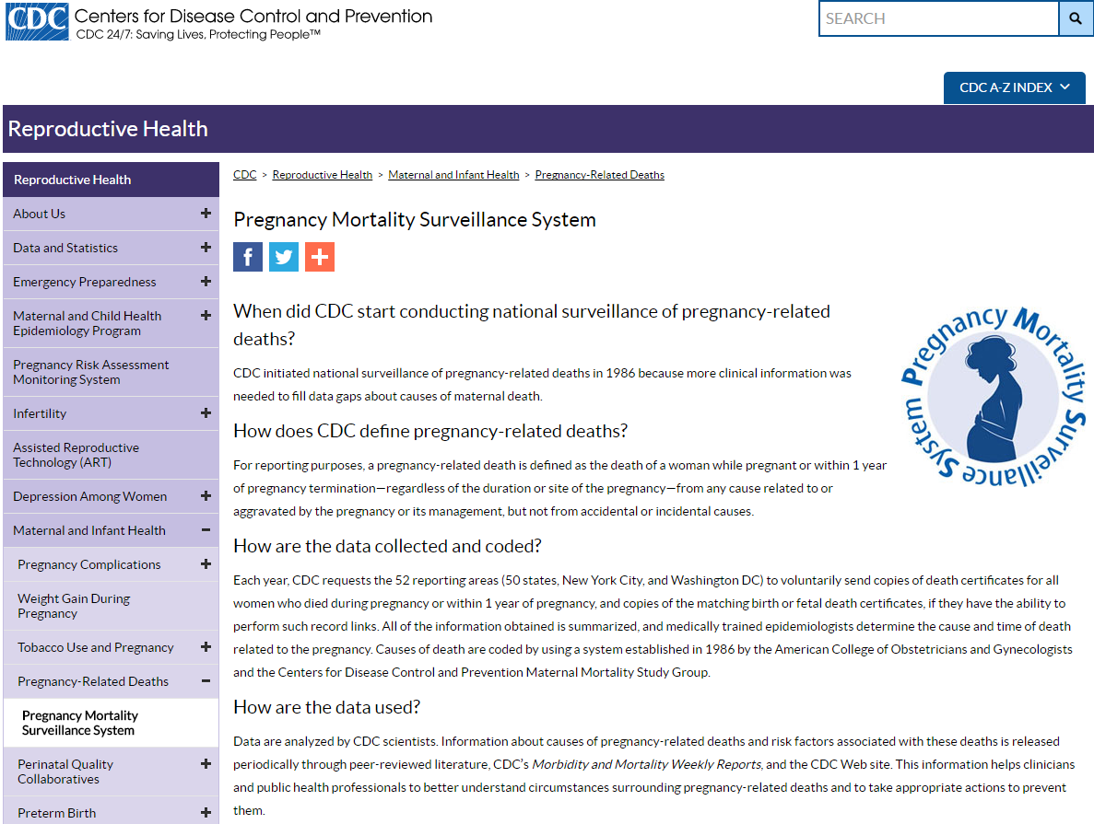
Pregnancy Mortality Surveillance System
Notes:
While all these problems arose with the official system of measuring maternal mortality in the U.S., the CDC established an independent system of measurement of maternal deaths dating back to 1987. Its process is described on the next slide.

Slide 73
Data for CDCs Pregnancy Related Mortality System
Each year, CDC requests the 52 reporting areas (50 states, New York City, and Washington DC) to voluntarily send copies of death certificates for all women who died during pregnancy or within 1 year of pregnancy, and copies of the matching birth or fetal death certificates, if they have the ability to perform such record links. All of the information obtained is summarized, and medically trained epidemiologists determine the cause and time of death related to the pregnancy. Causes of death are coded by using a system established in 1986 by the American College of Obstetricians and Gynecologists and the Centers for Disease Control and Prevention Maternal Mortality Study Group.
www.birthbythenumbers.org
Notes:
A solid system for measurement that didn’t disappear, though it still relies on the initial death certificates (and the problems associated with those) as its starting point. TWO PROBLEMS: (1) The CDC mortality ratios are only reported to 1 year after birth, not the 42 day international standard so their data are not comparable to other countries; and (2) Only the National Vital Statistics System can produce the official U.S. maternal mortality ratio. Why? System is apparently based on agreements that make the NVSS the official reporter.

Slide 74
Our best existing measure
Pregnancy Related Mortality, U.S., 1987-2019
Pregnancy Related Mortality Ratio (per 100,000 births)
Source: CDC. https://www.cdc.gov/reproductivehealth/maternal-mortality/pregnancy-mortality-surveillance-system.htm
www.birthbythenumbers.org
Notes:
This is the trend based on the Pregnancy Related Maternal Mortality Surveillance System. It documents a steady increase from 1987 through 2009. However, it’s also important to note that between 2009 and 2019 (their most recent year) the ratio has been essentially flat. It will rise in 2020 and especially in 2021 because of COVID, but will likely return to earlier (but too high) levels in 2022.

Slide 75
Timing of Maternal Deaths (2011-2015)
Source: Petersen E. et al. Vital Signs: Pregnancy-Related Deaths, United States, 2011–2015, and Strategies for Prevention, 13 States, 2013–2017. MMWR .vol.68. May 7, 2019. 1-7.
www.birthbythenumbers.org
Notes:
One other advantage of the CDC system is their identification of the timing of maternal deaths, which profoundly changes the way we look at maternal death. As this pie chart illustrates, the image that maternal deaths occur primarily at the time of birth is false. That’s the popular image in YV and media because it makes for a dramatic story (we’re looking at you Downton Abbey, Call the Midwife, The Resident, ER and of course Star Wars: Revenge of the Sith). The reality is much more complicated as only 1/3rd of maternal deaths are at the time of birth or the week thereafter. One third (31%) occur during pregnancy and one third (33.1%) occur between one week and one year after birth. This suggests that reforms that focus only on in-hospital care at the time of birth will successfully resolve only one part of the problem.

Slide 76
Timing of Maternal Deaths (2017-19)
Source: Trost SL, Beauregard J, Njie F, et al. Pregnancy-Related Deaths: Data from Maternal Mortality Review Committees in 36 US States, 2017–2019. Atlanta, GA: Centers for Disease Control and Prevention, US Department of Health and Human Services; 2022.
www.birthbythenumbers.org
Notes:
This is an updated version based on data from 36 maternal mortality review committees, documenting an even smaller proportion of maternal deaths at the time of birth, with 53% between a week and a year after birth.

Slide 77
Pregnancy-related mortality ratio by urban-rural classifications: 2017-2019
Deaths per 100,000 Births
Source: CDC Website. https://www.cdc.gov/reproductivehealth/maternal-mortality/pregnancy-mortality-surveillance-system.htm#:~:text=The%20Pregnancy%20Mortality%20Surveillance%20System%20(PMSS)%20defines%20a%20pregnancy%2D,or%20aggravated%20by%20the%20pregnancy.e
www.birthbythenumbers.org
Notes:
This documents the higher rates of maternal deaths in rural areas in the U.S., a phenomenon exacerbated by the COVID pandemic.

Slide 78
Causes of pregnancy-related death in the U. S.: 2017-19
Source: CDC Website. https://www.cdc.gov/reproductivehealth/maternal-mortality/pregnancy-mortality-surveillance-system.htm#:~:text=The%20Pregnancy%20Mortality%20Surveillance%20System%20(PMSS)%20defines%20a%20pregnancy%2D,or%20aggravated%20by%20the%20pregnancy.e
www.birthbythenumbers.org
Notes:
CDC latest categorization of causes of death noting a concentration among cardiovascular diseases. Similar dated looking at causes of death over time is presented later.

Slide 79
Pregnancy Related Mortality Ratios by Race, U.S., 2017-2019
Source: CDC. https://www.cdc.gov/reproductivehealth/maternal-mortality/pregnancy-mortality-surveillance-system.htm
www.birthbythenumbers.org
Notes:
Here are the ratios from the PMSS for 2017-2019 combined and have the advantage of providing reliable data on more than just blacks and whites. The rate for American Indians/Alaskan Natives about 66% higher than those for whites and 89% higher than the ratio for Hispanic women. CDC hadn’t reported pregnancy related mortality ratios Hawaiian/Pacific Islander before and has now identified a population that needs further monitoring.

Slide 80
Pregnancy Related Mortality Ratios (per 100,000 births) by Race/Ethnicity, U.S. 2007-2018.
Source: Petersen E. et al. Racial/Ethnic Disparities in Pregnancy-Related Deaths — U.S., 2007–2016 . MMWR. 9/6/19; 68(35):762-765. & CDC Website (2016-18).
www.birthbythenumbers.org
Notes:
Over recent times, while the black/white disparity is profound, so is that between American Indian/Alaskan Natives (AIAN), peaking in 2011-12 when the AIAN ratio was 3.1 times that of whites and almost as high as blacks (38.4 compared to 44.3).

Slide 81
Pregnancy-related mortality ratios (per 100,000 live births) by race/ethnicity, U.S. 2007-2016
Source: Petersen E et al. Racial/Ethnic Disparities in Pregnancy-Related Deaths — United States, 2007–2016. MMWR 2/7/19; 68 (35): 762-765.
www.birthbythenumbers.org
Notes:
Perhaps this is the most profound way to summarize the power of racial disparities – a college educated black mother has a 65% greater chance of a maternal death than a white women with < a high school education.

Slide 82
Pregnancy-related mortality ratios (per 100,000 live births) by race/ethnicity, U.S. 2007-2016
Source: Petersen E et al. Racial/Ethnic Disparities in Pregnancy-Related Deaths — United States, 2007–2016. MMWR 2/7/19; 68 (35): 762-765.
www.birthbythenumbers.org
Notes:
It’s striking that in contrast to black/white differences, where black ratios don’t decline with greater education, in the case of AIAN, there is a steady decline associated with increased education though not as necessarily as quickly as in the case of white mothers. Still a similar comparison can be made. An AIAN women with some college education is still 28% more likely to experience a maternal death than a white woman with less than a high school education.

Slide 83
Moving from the CDC Pregnancy Related Mortality Surveillance to the National Vital Statistic System Data
Notes:
While the CDC system has the advantage of careful review of a broader set of records, the NVSS has the advantage of speed with reporting of 2021 results by March of 2023. Both systems have their values, but they’re not the same.

Slide 84
www.birthbythenumbers.org
Notes:
The 2021 rates have been released and they continue the bad news with the official ratio increasing to 32.9 per 100,000.

Slide 85
Maternal Mortality Ratios (per 100,000 live births), U.S. 1987-2022 (2022 is provisional)*
Official NVSS Rate
Estimated from PMSS
Maternal Mortality Ratio
# 2018-21 Official Ratios
# 1987-2007 & 2018-21 based on official NVSS reported ratio; 2008-2016 estimated based on Pregnancy-Related Mortality Ratio limited to 42 days postpartum.
Source: Adapted from: Callaghan W. https://www.cdc.gov/grand-rounds/pp/2017/20171114-presentation-maternal-mortality-H.pdf
www.birthbythenumbers.org
Notes:
This draws from 3 data sources. The data from 1987 to 2007 is from the old NVSS system that stopped reporting after 2007 for reasons discussed in section 3. The dotted line is based on the CDC’s Pregnancy Related System. As you’ve seen, the CDC ratio is based on deaths up to 1 year postpartum, but we’ve adjusted it to only include deaths up to 42 days postpartum, to allow for a comparison with the NVSS ratio. We report both of thme for the two years thus far (2018-2019) when they overlap.
The flattening of the upward trend from 2008-2019 is more evident here. Also notable is how much higher the official NVSS based 2018 & 2019 ratio is compared to the adjusted PMSS ratio from the same years as we’ll see more clearly on the next slide.

Slide 86
Comparing CDC & NVSS Estimates of U.S. Maternal Mortality, 2018 & 2019
Maternal Mortality Ratio
NVSS – National Vital Statistics System; CDC – Pregnancy Mortality Surveillance System
Sources: NVSS Hoyert. Maternal mortality rates in the United States, 2021. NCHS Health E-Stats. 2023; CDC: adapted from https://www.cdc.gov/reproductivehealth/maternal-mortality/pregnancy-mortality-surveillance-system.htm .
Notes:
Comparing the two major measures of maternal mortality reveal a growing distinction in the rates in the two years for which we have both rates with the 2019 NVSS ratio (pre-COVID) 63% higher than the CDC measure.

Slide 87
Summary
The Pregnancy Related Maternal Mortality System provides a reasonable alternative to the National Vital Statistics Syst. & it documented a steady increase in maternal deaths, 1987 to 2005.
It has also shown a plateauing of the ratio from 2008-2019, though the difference between the two ratios in 2018-2019 has increased.
The question is whether that plateauing is at an acceptable level and for that we need to place the U.S. in a comparative context.
The resumption of the official reporting shows a rapid increase from 2018-2021, partially the result of the COVID pandemic.
www.birthbythenumbers.org

Slide 88
5. Comparing the U.S. to the Rest of the World
www.birthbythenumbers.org

Slide 89
U.S. in a Comparative Context, 1910, 1927, 2020
 | 1901-1910¹ | 1927 ² | 2020 ³
 | per 100K births | per 100K births | per 100K births
Norway | 290 | 245 | 2
Australia | 530 | 592 | 3
Italy | 270 | 264 | 5
Sweden | 230 | 278 | 5
Northern Ireland | 550 | 480 | 5
New Zealand | 460 | 491 | 7
France | 520 | 287 | 8
England & Wales⁴ | 410 | 411 | 10
United States⁵ | 650 | 647 | 24
Sources & Notes: 1. Meigs. Maternal Mortality in U.S. & other countries. 1917; 2. Tandy. Comparability of Maternal Mortality Rates in the United States and Certain Foreign Countries. 1933; 3. WHO. Trends in Maternal Mortality, 2000-2020; 4. UK rate in 2020; 5. Based on 10 reporting areas (CT,ME,MA,MI,NH,PN,RI,VT,NYC, DC) in 1910 & about 90% of all births in 1927.
www.birthbythenumbers.org
Notes:
Historically, the U.S. has long been doing worse than other industrialized countries, ranking last – by a wide margin – across the past century.

Slide 90
Maternal Mortality Ratios (per 100,000 births), 2020
Countries in green have fewer than 100,000 births.
Let’s do a more reasonable comparison
Source: WHO. Trends In Maternal Mortality, 2000-2020. (Geneva, 2023) . U.S. CDC Wonder
www.birthbythenumbers.org
Notes:
Among the countries listed in the most recent WHO report on maternal mortality, the U.S. ranks about 69th between China and Armenia. This should be a major embarrassment to the U.S., However, care should be taken when making country comparisons on maternal mortality, since, except in very large, impoverished countries, maternal deaths will be relatively rare (< 1 in 1,000 births), so ratios can fluctuate widely. As noted in the slide, the countries in green in this figure have fewer than 100,000 births a year.
What if we did a more reasonable comparison? Let’s examine comparably wealthy countries with at least 300,000 births annually and see where the U.S. stands.

Slide 91
U.S. Maternal Mortality Ratio (per 100,000 births ) Compared to Industrialized Countries with 300,000+ births, 2020
Source: OECD Health Data 2023 & U.S. Hoyert DL . NCHS Health E-Stats; 3/23.
www.birthbythenumbers.org
Notes:
In this comparison, the U.S. is no longer 69th, we’re now 10th….out of 10. One rationalization used to explain the poor U.S. performance is that we are a more diverse society than our comparison countries. What if we revised this comparison?

Slide 92
U.S. Maternal Mortality Ratio (per 100,000 births ) Compared to Industrialized Countries with 300,000+ births, 2020
Source: OECD Health Data 2022 & U.S. Hoyert DL . NCHS Health E-Stats; 3/23.
www.birthbythenumbers.org
Notes:
One rationalization used to explain the poor U.S. performance is that we are a more diverse society than our comparison countries. However, as the figure illustrates, even if we limit the U.S. data to just non-Hispanic White women, the U.S. would still rank last by a wide margin. That’s not to underestimate the profound racial disparities in U.S. maternal deaths (more on that in the next section), but it does suggest that there are more systematic factors underlying the poor U.S. performance.

Slide 93
Maternal Mortality Ratio (per 100K births), 2000-2021,
U.S. & Comparable Countries*
* Countries with 300,000+ births (2017): Australia, Canada, France, Germany, Italy, Japan, S. Korea, Spain, United Kingdom
Sources: OECD Health Data 2021; & U.S. Estimated from NVSS & Pregnancy Mortality Surveillance System
www.birthbythenumbers.org
Notes:
Start by placing US in a global context.
The comparison here is to our 9 other comparison countries with at least 300,000 births. The red line represents the average maternal mortality ratio for those countries. The trend data for the U.S. ratio is based on a combination of official NVSS data from 2000-2007 and 2018-2021 while 2008-2017 is an estimate from CDC data. US data estimated from CDC’s Pregnancy Mortality Surveillance System because NVSS did not report the maternal mortality rate between 2007 and 2018 due to concerns about measurement of maternal deaths.
Two key findings: (1) The comparison countries in 2000 had an average maternal mortality rate (6.3) half that of the U.S. (12.6); and (2) Between 2000 and 2020, the average for the comparison countries declined slightly while the U.S. ratio after remaining around 13/100,00. By 2018, the U.S. rate was 3.1 times the rate of the comparison countries. If we use the U.S. official 2020 rate of 23.8 per 100,000 compared to the comparison countries the U.S. ratio was 3.5 times the average for the 9 comparison countries.
The reference to case ascertainment involves a major claim for the US poor standing is that the US has improved its identification of cases of maternal deaths. However, the argument is difficult to sustain when one considers that the other countries the US is being compared to are also improving their case ascertainment as well. It may be that better ascertainment accounts for the relatively small decrease for the comparison countries as well as the a portion of the rise in the US rate.

Slide 94
Summary
No matter how you structure a comparison, the U.S. fares poorly in cross-national comparisons.
If you include all countries, the U.S. ranks in the 60s; if you limit it to large wealthy countries, the U.S. ranks 10th…out of 10 countries.
In terms of comparative trends, the U.S. in 2000 had a maternal mortality rate double the average for the comparison countries and over the next 20 years fell further behind.
www.birthbythenumbers.org

Slide 95
6. The Persistence of Racial Disparities
www.birthbythenumbers.org

Slide 96
U.S. Maternal Mortality (per 100,000 live births), 1951-2007 by Race
Source: NCHS. Maternal Mortality and Related Concepts. Vital & Health Statistics. Series 33; #3. & annual data reports. 1915-1960 data from NCHS. Vital Statistics Rates In The United States 1940-1960. NOTE: Shifts in measurement (e.g. not all states were part of registration system prior to 1933; infant race was based on race of the child until 1980 & then race of the mother post 1980) accounts for some of the variation over time. 2007-2016 based on 2 year estimates of the pregnancy related mortality rate: Petersen E. MMWR.9/6/19.
www.birthbythenumbers.org
Notes:
The Black-White disparities we cite so regularly now are neither new nor much different than those in the past. The main difference is that maternal mortality rates for both Black and White women have come down, but the persistence of black rates being 3-4 times higher than White rates has been consistent. Interestingly at the beginning of the period described above an editorial in JAMA bragged about the maternal mortality ratio in the U.S. getting to what it described as the “the apparently irreducible minimum” of 1 in 1,000 overall (or 100 per 100,000 in current terms), the ratio for Black mothers was still more than twice that figure.

Slide 97
Black to White Ratios, U.S. Maternal Mortality, 1915-2021
Maternal Mortality
Ratio
Source: NCHS. Maternal Mortality and Related Concepts. Vital & Health Statistics. Series 33; #3. & annual data reports. 1915-1960 data from NCHS. Vital Statistics Rates In The United States 1940-1960. NOTE: Shifts in measurement (e.g. not all states were part of registration system prior to 1933; infant race was based on race of the child until 1980 & then race of the mother post 1980) accounts for some of the variation over time. 2007-2016 based on 2 year estimates of the pregnancy related mortality rate: Petersen E. MMWR.9/6/19.
www.birthbythenumbers.org
Notes:
This presents the ratios themselves. Notably the disparities rise steadily from 1933, when all states are finally part of the reporting system, from about 2 to more than 3 times by the late 40s and generally stays between 3 to 4 for the next 70 years. Of late the ratio is between 2.5 to 3.0.

Slide 98
Black to White Ratios, U.S. Infant & Maternal Mortality, 1915-2021
Maternal Mortality
Ratio
Infant Mortality
Source: NCHS. Maternal Mortality and Related Concepts. Vital & Health Statistics. Series 33; #3. & annual data reports. 1915-1960 data from NCHS. Vital Statistics Rates In The United States 1940-1960. NOTE: Shifts in measurement (e.g. not all states were part of registration system prior to 1933; infant race was based on race of the child until 1980 & then race of the mother post 1980) accounts for some of the variation over time. 2007-2016 based on 2 year estimates of the pregnancy related mortality rate: Petersen E. MMWR.9/6/19.
www.birthbythenumbers.org
Notes:
To put this in context, this presents a comparison of black-white ratios for maternal mortality and infant mortality. The infant mortality disparities are profound enough with black infant mortality consistently 2 or more times the rate for white infants, with the ratio about 2.5 times for the last 30 years. As unacceptable as that disparity is, it is still substantially smaller than the disparity in maternal mortality rates. The reason is simple – while we have a flawed maternity care system, it is geared far more to the protection of the health of infants more than their mothers.

Slide 99
U.S. Maternal Mortality, by Race/Ethnicity, 2018-2021
 | 2018 | 2019 | 2020 | 2021
Non-Hisp. White | 14.9 | 17.9 | 19.1 | 26.6
Non-Hisp. Black | 37.3 | 44.0 | 55.3 | 69.9
Hispanic | 11.8 | 12.6 | 18.2 | 28.0
Non-Hisp Asian | 13.3 | 13.8 | 12.3 | 24.3
Non-Hisp. AIAN | * | 49.2 | 48.5 | 118.7
All | 17.4 | 20.1 | 23.8 | 32.9
40 years of Age +
All | 81.9 | 75.5 | 107.9 | 138.5
Source: NVSS Hoyert. Maternal mortality rates in the United States, 2021. NCHS Health E-Stats. 2023; CDC Wonder; * < 10 deaths
www.birthbythenumbers.org
Notes:
The impact of the pandemic is clearly seen as disparities grow more extreme and Hispanic ratios are now higher than those for White non-Hispanics. Of particular concern is the extraordinary ratio for American Indian/Alaskan Natives.
While there are more concerns about false positives for those giving birth at 40+ in age the ratios for that group are extraordinarily high.

Slide 100
Maternal mortality rates, by race & Hispanic origin and age: United States, 2021
Maternal deaths per 100,000 births
Source: Hoyert DL. Maternal mortality rates in the United States, 2021. NCHS Health E-Stats. 2023.
DOI: https://dx.doi.org/10.15620/cdc:124678.
www.birthbythenumbers.org
Notes:
This shows differences by both race and age including women 40+. The ratios for blacks are 137% higher than whites, but the high ratios among women over 40 suggests once again that the problems with false positives associated with the pregnancy checkbox have not been completely resolved.

Slide 101
Manifestation of Racial Disparities 2017-2019
Leading Underlying Causes of Pregnancy- Related Deaths, by Race-Ethnicity
Source: Trost SL, et al. Pregnancy-Related Deaths: Data from Maternal Mortality Review
Committees in 36 US States, 2017–2019. Atlanta, GA: CDC, 2022.
www.birthbythenumbers.org
Notes:
This 36 state study of underlying causes of maternal deaths finds some similarities (hemorrhage is high in both cases) , but notable differences between causes of death by race/ethnicity. Cardiac related conditions and embolism accounted for 45% of the deaths of Black mothers, but only 27% of the deaths to white mothers. Alternately, mental health conditions (which often include substance issues) were rarely the cause of death for Black mothers (7%) but cited in 35% of the deaths of White mothers.

Slide 102
Cause-specific pregnancy-related mortality, by race/ethnicity, U.S., 2007-2016 (%)
14%
14%
15%
16%
12%
17%
14%
14%
15%
15%
17%
15%
20%
20%
16%
AIAN – American Indian, Alaskan Native; Asian PI – Asian Pacific Islander
Source: Petersen E et al. Racial/Ethnic Disparities in Pregnancy-Related Deaths — United States, 2007–2016. MMWR 2/7/19; 68 (35): 762-765.
www.birthbythenumbers.org
Notes:
THREE NOTES: (1) The respective pregnancy related mortality ratios for each group is listed next to each group. That’s important to keep in mind given the bars represent the proportions within each of these groups and (2) The large proportions of cases listed in the “other” categories represent another failure of the U.S. system of measurement, with 35% overall, and 37% of the causes of deaths of white and Black women being classified as “other.”
(3) This is an alternate way to examine the variation in the causes of death. Looking across the race/ethnicity groups, one can see the higher proportions of deaths attributed to infection, for example, among Asian Pacific Islander and Hispanic mothers, while hemorrhage (severe bleeding) is a more common cause of death among American Indian/Alaskan native mothers and Asian PI mothers.

Slide 103
Maternal Mortality (per 100,000 births) by Race,
U.S. (2020) and England (2018-2020)
Sources: U.S., Hoyert DL . NCHS Health E-Stats; 2/22/22; MBRRACE-UK. UK and Ireland Confidential Enquiries into Maternal Deaths and Morbidity 2018-20. Oxford:NPEU, 2022.
www.birthbythenumbers.org
Notes:
Just for context, here are the data from the UK & Ireland Enquiries by race and of course what’s notable is the similarity between the ratios by race in the two countries. Racial disparities are not exclusive to the U.S., but the rate for both Blacks and Whites are far lower in the UK.

Slide 104
Summary
Racial disparities in maternal mortality have existing in the U.S. as long as data has been collected.
The consistency of the disparity with Black maternal mortality ratios 3 to 4 times that of white maternal mortality for decades reflects the lack of progress made in the U.S.
Presently, the disparity does not reflect SES differences, with maternal education providing no protection for Black mothers.
The maternal mortality ratios for American Indian/Alaskan natives were also far higher than those for white and Hispanic mothers.
www.birthbythenumbers.org

Slide 105
7. Maternal Mortality during a Pandemic

Slide 106
2018-2022 COVID & Maternal Deaths Update
1,205
861
Total Maternal Deaths
647
Provisional
Source: CDC Wonder Mortality File
Notes:
This is a simple breakdown of total maternal deaths (through 42 days postpartum) across the most recent 4 years of data plus provisional 2022 data. The cases identified as COVID have a question mark because COVID isn’t included as an underlying cause of death. The 429 identified deaths in 2021 are cases that also had COVID included as a secondary cause. Of course, many of the other deaths may have been impacted by COVID barriers to care or limiting access to hospitals. The 2022 results are provisional, though the provisional figures are generally quite close to the final figures so can give us a reliable sense of direction rather than a specific number.

Slide 107
Maternal Deaths (Preg-42 days ppm)per Month, 2019-2022 (2022 Provisional)
pandemic
2019
2020
2021
2022

Slide 108
U.S. Maternal Deaths per Month, 2019-2022 (2022 Provisional)
Total Maternal Deaths
Source: CDC Wonder Mortality File
Notes:
Looking at each year by month reveals the stunning impact of COVID in August-Oct., 2021 when an average of about 70 deaths a month in every other year more than doubles to an average of 150 deaths a month in those months. Ratios for 2022 cannot be calculated because we don’t yet have estimates of 2022 births, which serve as the denominator.

Slide 109
MM (per 100,000 births) by Month, 2018-2021
2018
2019
2020
2021
Notes:
These are the maternal mortality ratios, showing a similar attern.

Slide 110
Pregnancy Related # Death Ratios with & without a COVID Code by Race-Ethnicity, April, 2020 – December, 2021
Pregnancy Related Mortality per 100,000 Births
# Deaths during pregnancy and up to 1 year after delivery;
*AIAN – American Indian Alaskan Native
Source: CDC Wonder
Notes:
This breaks down pregnancy related deaths by race/ethnicity and by those cases with and without a COVID secondary code during the pandemic (April, 2020-Dec., 2021). Several interesting points: (1) The ratio for non- Hispanic AIAN are extraordinarily high. Their ratio of deaths associated with COVID (38.8) is higher than the overall ratio for all groups except non-Hispanic Blacks. (2) While Hispanics have a lower ratio than Whites without COVID, their COVID cases are almost double that of Whites resulting in an overall higher ratio. (3) Non-Hispanic Blacks overall rate of 90.5/100,000 emphasizes the disparate impact of COVID on different groups.

Slide 111
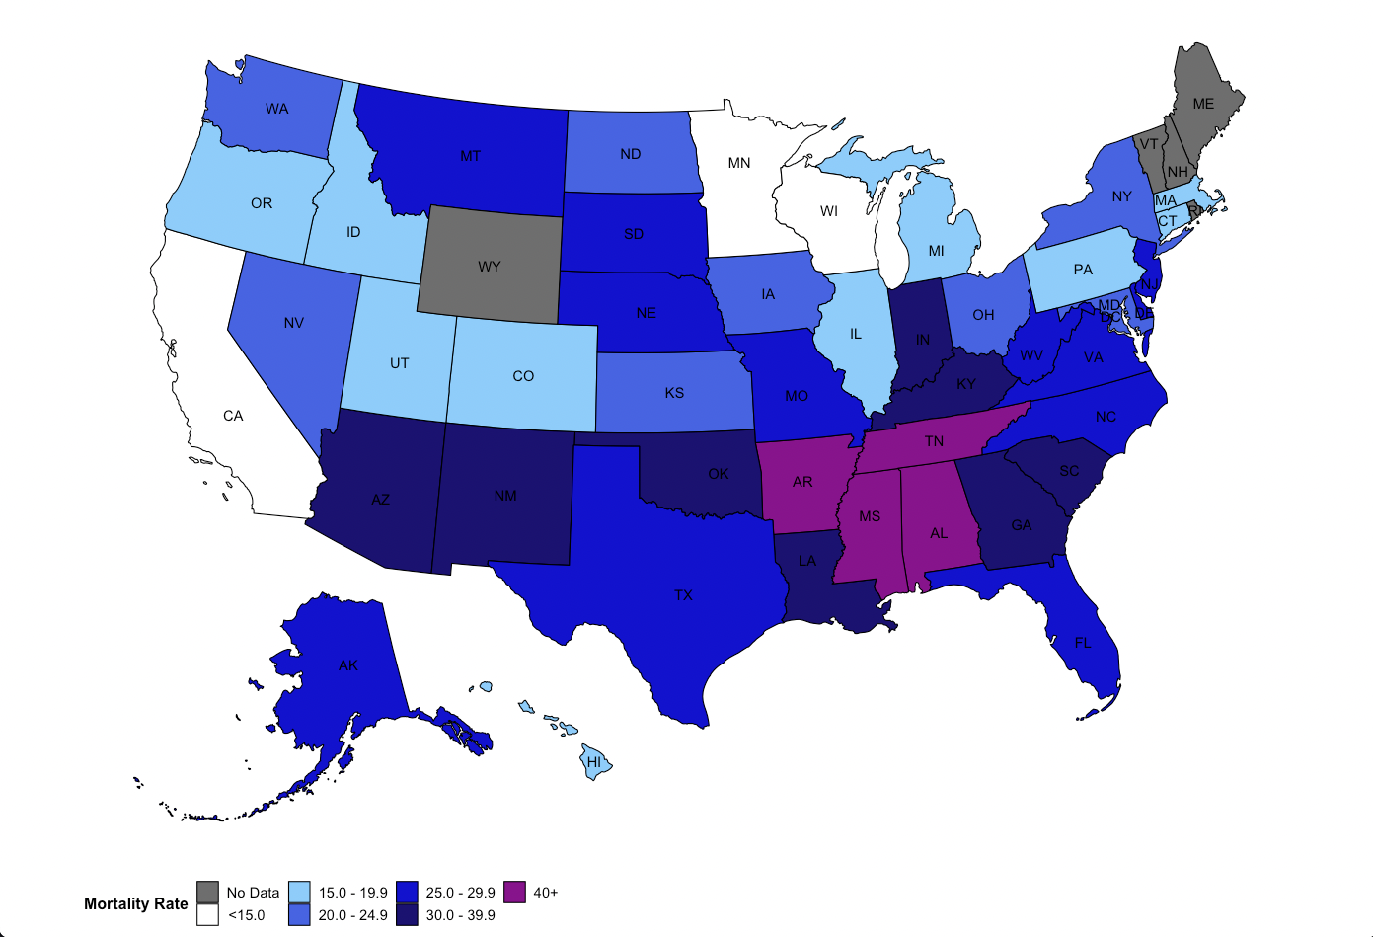
Maternal Mortality Ratio, U.S. States*,
2018-21
Source: CDC Wonder
* States with < 10 maternal deaths, 2018-2020, are excluded from reporting
Notes:
It presents a familiar pattern with high ratios in the deep South and generally lower rates on the West Coast and Northeast.
5 states (Maine, New Hampshire, Rhode Island, Vermont & Wyoming) had fewer than 10 maternal deaths and so aren’t reporting a rate, but obviously they potentially had a low ratio if they’re averagng less than 3 maternal deaths a year.

Slide 112
Pregnancy Related Mortality* by State during the Pandemic (2020Q2-Q4, 2021)
Pregnancy Related Deaths per 100,000 births
* States with > 10 maternal deaths
Source: CDC Wonder
Notes:
This provides specific ratios for the individual states and shows the wide variation across states with ratios for Mississippi and Alabama three times higher than ratios for California and Minnesota.

Slide 113
Pregnancy Related Mortality (per 100,000 births) 2020-2021* and % Female State Legislators 2021
MS
r =-.46
p < .01
AL
NM
TN
NC
LA
AR
SC
SD
GA
Maternal Mortality Ratio
MO
KY
VA
MT
IN
TX
AZ
OH
OK
IA
NJ
FL
WV
ID
NY
OR
MI
IL
NV
PA
KS
MD
UT
WI
CT
CO
NE
MA
CA
MN
WA
* 41 states with at least 10 maternal deaths April, 2020– Dec. 2021.
% Female Legislators
Sources: % Female Legis – Nat’l Conf State Legisl.; Pregnancy Related Mortality – CDC Wonder
Notes:
In case you wonder whether political systems can make a differences, this illustrates a strong relationship between the proportion of female state legislators in a state and its pregnancy related mortality ratio.

Slide 114
State Pregnancy Related Mortality (per 100,000 births) (4/20-12/21) & Vaccination Rates
MS
r =-.56
p < .01
NM
AL
TN
LA
AR
NC
GA
SC
SD
VA
Maternal Mortality (per 100,0000) during Pandemic
KY
TX
MO
AZ
IN
OH
IA
NJ
OK
MI
OR
NY
ID
NV
FL
IL
WV
NE
MD
CT
PA
CO
KS
WI
WA
UT
MN
MA
CA
Proportion of Population Fully Vaccinated
Sources: Vaccination NYTimes 10/20/22; Mat Mort: CDC Wonder
Notes:
There’s also a strong relationship between a state’s proportion of the population fully vaccinated and pregnancy related mortality. The higher the proportion of population fully vaccinated the lower the states pregnancy related mortality ratio.

Slide 115
Average Pregnancy Related Mortality* in Medicaid Expansion and non-Expansion States, 2018-2021
Non-Expansion States:
Notes:
Staying with the relationship between policy and mortality, this illustrates a strong relationship between whether a state expanded Medicaid and its pregnancy related mortality ratio. Notably, the disparity is increasing over time.

Slide 116
Summary
The COVID pandemic contributed more than 50% to the number of maternal deaths in 2021. It appears to have lost its mpact in 2022.
The pandemic exacerbated existing disparities between different groups, with especially high ratios among American Indians/Alaskan Natives and non-Hispanic Blacks.
State political systems appear to be related to the likelihood of a pregnancy related death.

Slide 117
8. Maternal Mortality as a Public Health Problem: Timing & Causes of Death
www.birthbythenumbers.org

Slide 118
Timing of Maternal Deaths (2017-19)
Maternal deaths are a public health issue as much as a clinical care issue.
Source: Trost SL, Beauregard J, Njie F, et al. Pregnancy-Related Deaths: Data from Maternal Mortality Review Committees in 36 US States, 2017–2019. Atlanta, GA: Centers for Disease Control and Prevention, US Department of Health and Human Services; 2022.
www.birthbythenumbers.org
Notes:
This is an updated version based on data from 36 maternal mortality review committees, documenting an even smaller proportion of maternal deaths at the time of birth, with 53% between a week and a year after birth.
As noted above, this distribution suggests that the focus on clinically based solutions is appropriate and necessary, but insufficient to address the full scope of problems associated with maternal mortality. An integrated approach encompassing clinical and public health approaches, hospital and community initiatives, as well as policy reforms will be the only way to sufficiently combat maternal mortality.

Slide 119
Maternal Mortality as a Public Health Problem
Cause-specific proportionate Pregnancy-Related mortality: U. S., 1991–2018.
% of Pregnancy Related Deaths
-40%
-57%
+5%
-17%
-35%
-88%
+161%
+62%
+49%
-5%
Source: Creanga. Pregnancy-Related Mortality in the United States. Obstet Gynecol 2017(1991-2013); CDC PRMSS (2016-2018).
www.birthbythenumbers.org
Notes:
This presentation of the patterns of causes of maternal deaths shows declining proportions of deaths associated with specific clinical causes and a rise in cardiovascular related causes, many of which do not manifest until the postpartum period.

Slide 120
Pregnancy-related deaths, by cause of death and timing of death relative to the end of pregnancy, 2011-15
17%
14%
24%
14%
19%
15%
15%
19%
18%
24%
13%
41%
24%
12%
16%
21%
12%
26%
20%
Source: PetersenE. Vital Signs: Pregnancy-Related Deaths, U.S., 2011–2015. MMWR 2019; 68:423-29.
www.birthbythenumbers.org
Notes:
This presents the causes of death by the timing of death and the different patterns are apparent. The three leading causes in each case are labeled. During pregnancy, the less well defined causes account for almost half (46%) of all deaths, while on the day of delivery hemorrhage and embolism make up half of the cases. In the week after birth hemorrhage, hypertension and infection account for more than half of the deaths, while between the first and 6th week infection, hypertensive disorders and other cardiovascular conditions make up a majority of the cases. Between 6 weeks and a year after birth, the picture changes dramatically with 2 in 5 deaths attributed to weakened heart muscles (cardiomyopathy) while the less specific causes account for another third of deaths.

Slide 121
Moving to a Public Health Approach
Underlying Causes of Pregnancy-Related Deaths, by Timing of Death
%
Source: CDC. 2018. Report from 9 Maternal Mortality Review Committees.
www.birthbythenumbers.org
Notes:
This is another way to approach the analysis of cause of death. Rather than rely on death records as in the previous figure, we can look at the results form a study based on reports from 9 maternal mortality review committees (MMRCs). MMRCs review individual cases of maternal deaths, including the death record, but also other materials (e.g. prenatal records, hospital reports, media accounts). Their classifications try to focus on underlying causes of death. As you can see there are many overlaps with the official records, however, one of the primary differences is that unlike medical records these analyses include the category of mental health difficulties as an underlying cause and that becomes notable, particularly in the postpartum period.

Slide 122
Summary
If only a quarter of maternal deaths occur at the time of birth, solutions have to look beyond the birth hospitalization to improve outcomes.
We have made considerable strides in improving care at the time of birth. The recent increases have been largely among cardiovascular conditions, many of which only manifest after the birth.
There are clearly different patterns of causes of death by timing indicating a need for more nuanced approaches.
Research into the underlying causes of death suggests a need for a greater focus on maternal mental health, particularly in the postpartum period.
www.birthbythenumbers.org

Slide 123
9. The Issue is Broader than Maternal Mortality
www.birthbythenumbers.org

Slide 124
Not just about maternal mortality
www.birthbythenumbers.org
Notes:
In looking at death reports, I noticed an interesting change in trend in overall death rates for women of reproductive age(see circled data). While overall death rates had gone down for most age groups, for women 15-44, the rates had leveled and even gone up. These aren’t maternal mortality data – these are overall death rates for women, so now we’re not dealing with 700 deaths a year, but more like 55,000 deaths of women.

Slide 125
The Problem is Bigger than Maternal Mortality
Overall Deaths rates (per 100K), Females 15-44, 1999-2021
Non-Hispanic AIAN
Non-Hisp. Black
All
Non-Hisp. White
Hispanic
Non-Hispanic Asian
Source: CDC Wonder
www.birthbythenumbers.org
Notes:
Here are overall death rates for women 15-44 since 1999. For most groups, except American Indian Alaskan Natives(AIAN), maternal death rates were relatively level for the first decade of the 21st century. After 2010 and especially after 2013, the rates began to rise in all groups, particularly spiking among AIAN women. Of course the death rates particularly spiked during the pandemic.

Slide 126
The Problem is Bigger than Maternal Mortality
Overall Deaths rates (per 100K), Females 15-44, 2010-2021
Non-Hispanic AIAN
Non-Hisp. Black
Non-Hisp. White
All
Hispanic
Non-Hispanic Asian
All Female Deaths 15-44
-- 47,427; 2021 – 78,110 (COVID 8,885)
Source: CDC Wonder
www.birthbythenumbers.org
Notes:
Here are overall death rates for women 15-44 2010-2021. The surge in death rates for American Indian Alaskan Natives(AIAN), particularly during the pandemic with an overall increase of 59%. Even prepandemic (2010-2019) the increase was 13.3%. Recall this was at a time when the maternal mortality ratio was relatively unchanged. Also, the magnitude of the impact of overall female deaths was more profound as we’re considering not 700 deaths a year, but 70,000 a year.

Slide 127
Ratio of Black/White Female Death Rates, Women 15-44, 2000-2021
NHW Rate Increase 2000-2021: 53%
NHB Rate Increase 2000-2021: 26%
Source: CDC Wonder
www.birthbythenumbers.org
Notes:
The irony is that in terms of overall female death rates for women 25-34, the black white disparity has actually been going down. However, I don’t think this is what was intended by those advocating for our societal goal of eliminating disparities. It is based more on the steadily increasing white rate than in a decreasing rate among Black women. However, the increase in the ratio since 2017 could signal the beginning of a disturbing new trend.

Slide 128
Problem is Bigger than Maternal Mortality
Top 10 Causes of Death for Women 15-44 in 2021
 | 2021 Total Deaths | % of total | Rate per 100 K | % Change in rate 2010-2021 | Proportion of 2010-21 Increase
All causes | 78,110 | 100.0 | 120.0 | 57.9% | ---
Accidents (unintentional inj.) | 23,562 | 30.2% | 36.5 | 96% | 38.9%
COVID-19 | 8,885 | 11.4% | 13.8 | --- | 29.0%
Malignant neoplasms | 8,740 | 11.2% | 13.5 | -8% | -1.2%
Diseases of heart | 5,694 | 7.3% | 8.8 | 21% | 3.7%
Intentional self-harm (suicide) | 4,549 | 5.8% | 7.0 | 27% | 3.6%
Assault (homicide) | 3,032 | 3.9% | 4.7 | 57% | 3.7%
Chronic liver disease and cirrhosis | 2,858 | 3.7% | 4.4 | 175% | 6.0%
Diabetes mellitus | 1,747 | 2.2% | 2.7 | 59% | 2.2%
Pregnancy, childbirth & puerperium | 1,665 | 2.1% | 2.6 | 117% | 3.0%
Cerebrovascular diseases | 1,254 | 1.6% | 1.9 | 0% | 0.1%
All other causes (residual) | 16,124 | 24.8 | 21.2 | 19.5% | 10.1%
Sources: CDC, NCHS. Underlying Cause of Death 1999-2021 on CDC WONDER Detailed Mortality Database, released in 2022. Accessed at http://wonder.cdc.gov/ucd-icd10.html on Feb. 9, 2023
www.birthbythenumbers.org
Notes:
What’s the cause of the increase? First let’s note what it’s not from – pregnancy, diabetes, cerebrovascular diseases or cancer. The rise is driven largely by behavioral causes: (1) primarily accidents (unintentional injuries) which is a category that includes substance use as a main driver of this increase; (2) suicide; and to a lesser extent (3) liver disease, which has a large percent increase but on a smaller base.

Slide 129
Increases in Female Deaths (15-44) 2010-2021:
47% of the non-COVID increase came from 1 cause
78,110
47,427
Non-COVID
Increase: 21,798
Increase: 10,429
Notes:
The profound impact of substance use is seen here since almost half (47%) of the overall non-COVID related increase from 2010-2021 had “drug-induced” listed as a cause.

Slide 130
Increase in Drug Induced Deaths, Women 15-44, by Race/Ethnicity, 2010 & 2021
527%
Increase
384%
Increase
333%
Increase
208%
Increase
CDC, NCHS. CDC WONDER Online Detailed Mortality Database, released in 2020. Accessed at http://wonder.cdc.gov/ucd-icd10.html on Aug 12, 2022
www.birthbythenumbers.org
Notes:
This breaks down the increase in drug induced by race ethnicity. Non-Hispanic Whites dominate with 8,921 more drug induced deaths in 2021 than 2010, accounting for 64% of the overall increase. The largest relative increase (527%) was among non-Hispanic Blacks, but from a much lower base than Whites.

Slide 131
Summary
Pick your idiom: tip of the iceberg or canary in the coal mine – the 800 maternal deaths are a warning about a much larger problem in the U.S. -- the rising death rate among women of reproductive age.
While the pregnancy related mortality rate has remained steady since 2010, the overall death rate for women 15-44 has increased by 13% through 2019 and 59% overall when the pandemic is taken into account.
The death rate for non-Hispanic White women was rising 2010-2017 at a much faster rate than the rate among non-Hispanic black women, but that has shifted.
The primary cause of these increases in deaths is substance use.
www.birthbythenumbers.org

Slide 132
10. The Way Forward
www.birthbythenumbers.org

Slide 133
Preventability
Definition: A death is considered preventable if the committee determines there was at least some chance of the death being averted by one or more reasonable changes to patient, family, provider, facility, system and/or community factors.
Source: Berg CJ, Harper MA, Atkinson SM, Bell EA, Brown HL, HageML, et al. Preventability of
pregnancy-related deaths: results of a state-wide review. ObstetGynecol2005;106:1228–34.
www.birthbythenumbers.org
Notes:
The definition of preventability that has been applied to cases of maternal death.

Slide 134
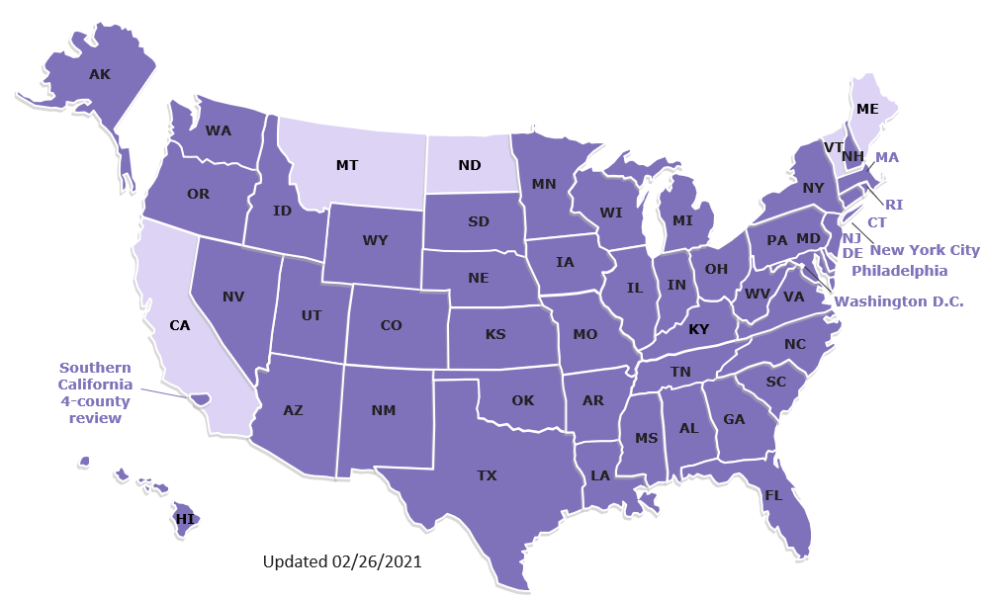
Maternal Mortality Review Committees (MMRCs) in 50 State and Local Jurisdictions
Notes:
MMRCs exist in 50 state and local jurisdictions.

Slide 135
The Challenge of Keeping Women in the Health System:
Insurance Coverage
www.birthbythenumbers.org

Slide 136
9. The Way Forward
Keeping Women in the System
Source: Daw J. Health Affairs 2017; 36:598-606
www.birthbythenumbers.org
Notes:
This data is now somewhat old (pre ACA), but it powerfully illustrates the nature of the problem we face in insurance coverage for maternity care. The green line (private insurance) remains relatively steady sloping down slightly across the 17 month period covered. More importantly, note the teal colored line that represents women with no insurance. Prior to getting pregnant about 23% of women had no insurance. By the time they give birth around 12% had no insurance with increases in Medicaid coverage filling the gap. By 5 months after they’ve had their baby, the uninsured figure rises back to about 23%. This isn’t random variation but a conscious policy position taken by our government to more generously cover women while they’re pregnant, but at 60 days postpartum, dropping the benefit for mothers, though not babies for at least 1 year.

Slide 137
Medicaid Eligibility for Parent vs Pregnant Women in 12 Non-Expansion States
Medicaid eligibility thresholds, Jan., 2023
Source: https://www.kff.org/health-reform/state-indicator/medicaid-income-eligibility-limits-for-adults-as-a-percent-of-the-federal-poverty-level/
www.birthbythenumbers.org
Notes:
This presents data from the Kaiser Family Foundation on eligibility for coverage while pregnant and not pregnant among states that did not expand Medicaid eligibility in conjunction with the ACA. For states that did expand, if an adult is making less than 138% of the poverty level, they can qualify for Medicaid. In these states, that figure may be as low as 16% of the poverty level (i.e. have an income of more than $3,636 for a family of 3), meaning it is almost impossible to qualify for Medicaid coverage. However, once a woman become pregnant, that limit is significantly raised as the figure illustrates. Of course, 60 days after giving birth, the original eligibility applies again and she’s may be denied Medicaid, while her infant will likely qualify until age 1.

Slide 138
Is expanding Medicaid eligibility out to 1 year postpartum the answer?
Sort of…
Since a significant proportion (30%) of maternal deaths occur between 42-365 postpartum, keeping women, especially vulnerable women, in the health care system makes sense.
There is also the matter of how women on Medicaid are treated when they are getting care.
www.birthbythenumbers.org

Slide 139
Survey Results (Adjusted Odds Ratios*) among women on Medicaid compared to private insurance
* Adjusted for maternal age, prenatal provider, race/ethnicity, maternal education, US born, pregnancy complications, and agreement with statement “childbirth shouldn’t be interfered with unless medically necessary.” All ratios significant at p < .05.
Source: Declercq, E. Women’s experience of agency & respect in maternity care by type of insurance in Cal.. PLOS One. 2020; 15(7): e0235262
www.birthbythenumbers.org
Notes:
These findings from a study of California women is a reminder that simply extending Medicaid doesn’t ensure equitable care. Women on Medicaid, even after controlling for a wide range of demographic and factors, were more likely to report being treated unfairly, not given a choice about having a VBAC, report being pressured to have a cesarean. They were also less likely to have a postpartum visit or be encouraged by staff to make their own decisions in labor.

Slide 140
States Implementing* 12 Month Extension of Postpartum Eligibility (as of 6/2/23)
Alabama
Arizona
California
Colorado
Connecticut
Delaware
District of Columbia
Florida
Georgia
Hawaii
Illinois
Indiana
Kansas
Kentucky
Louisiana
Maine
Maryland
Massachusetts
Michigan
Minnesota
New Jersey
New Mexico
North Carolina
North Dakota
Ohio
Oklahoma
Oregon
Pennsylvania
Rhode Island
South Carolina
Tennessee
Virginia
Washington
West Virginia
* Only lists states that have implemented the extension. Several more are planning to implement.
Source: https://www.kff.org/medicaid/issue-brief/medicaid-postpartum-coverage-extension-tracker/#note-0-37/
www.birthbythenumbers.org

Slide 141
Four Policy Recommendations to Reframe Maternal Deaths Review into Women’s Health Campaign
1. Use Maternal Mortality Review Committees to explore pregnancy associated deaths for causes and possible bases for prevention;
2. Use linked datasets to examine women’s health through the lifecourse and identify critical moments (e.g. pregnancy?) where intervention might matter;
3. Fund a systematic process for listening to women tell us about their lives and experiences in pregnancy and beyond to craft sustainable solutions that are meaningful to them.
4. Craft policies that keep women of all ages within the health and social system to prevent problems that lead to pregnancy associated deaths.
www.birthbythenumbers.org
Notes:
These represent only a start to addressing maternal mortality for what it is – a health challenge for all birth people across their lifespan and not just at the time of pregnancy.

Slide 142
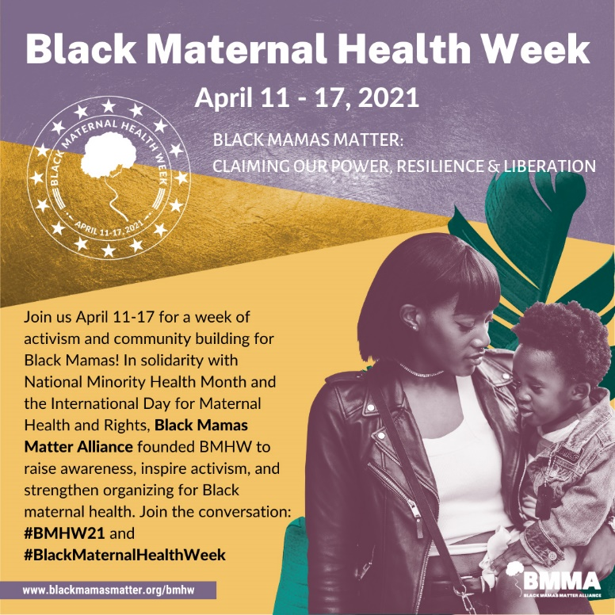
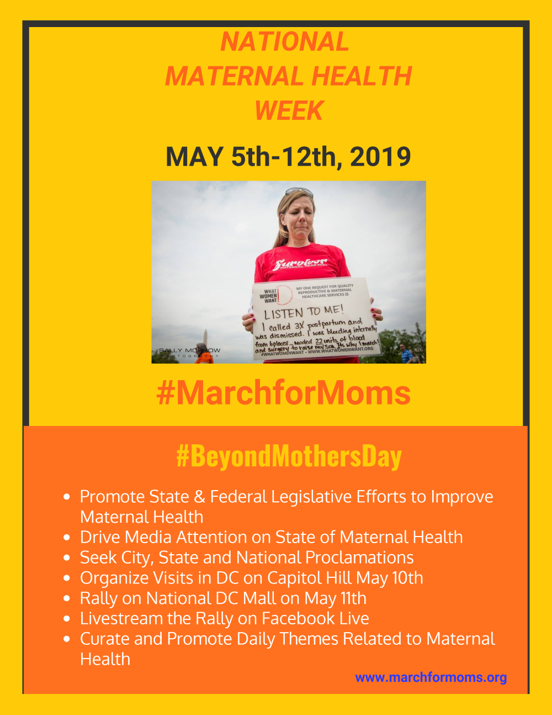
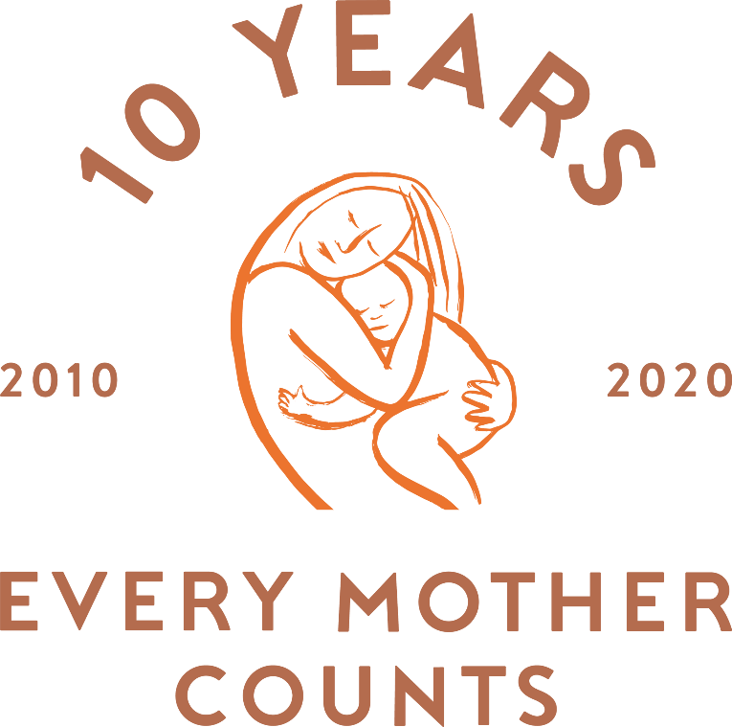







www.birthbythenumbers.org
Notes:
Advocacy opportunities abound and there’s a pressing need to turn this data into action.

Slide 143

























Maya
Sam
Lee
Corey
Lucy
Staige
Sheridan
Jessica
Brittany
Jordy
Kylia
Christina
Ruby
Isabelle
Katie
Annette
Ebere
Allison
Sarah
Veronica
Kali
Maura
Nairi
Juliana
www.birthbythenumbers.org
EMAIL: birthbynumbers@gmail.com
Gene
FACEBOOK: www.facebook.com/BirthByTheNumbers

