Slide 1
US Birth Outcomes in a Comparative Context
Update of Data from Birth By the Numbers.
These slides largely mirror those used in the video, but add some others of interest and update the originals with the most recent available data as of
July 1, 2013
Gene Declercq, PhD
NOTE: There is a lag of 2-4 years in the reporting of vital statistics from the US and abroad
BirthByTheNumbers.org
Notes:
As an example of the delay in releasing data, the 2010 final birth data was released in August, 2012. The preliminary 2011 data was released in October, 2012 which provides early data on teen birth rates, rates of cesareans and premature birth. The 2011 Final Data Births report was released on 6/28/2013. States will sometimes release data in a more timely way.

Slide 2
Key Question
Is the U.S. really doing as badly as it seems in international comparisons?
BirthByTheNumbers.org
Notes:
The context for this question are the annual reports (e.g. WHO Health Statistics or State of the Worlds Children) of international statistics which regularly report that the US ranks somewhere around 40th in measures like infant or neonatal mortality.
The problem with such claims is that they involve a number of countries that are not comparable to the US in size, wealth or demographic diversity.

Slide 3
Is the U.S. really doing that badly?
How Do we Compare Outcomes?
Neonatal Mortality Rate
Infant Deaths in
First 28 days
X 1,000
________________
Live
Births
Notes:
Helps to note what this captures (early deaths) and what it does not, especially in cross-national comparisons. It is only a rough measure of the quality of the maternity care system since some of the causes of death (e.g. congenital anomalies) predate childbirth and have nothing to do with the childbirth itself. Also different countries can have different customs concerning how a live birth is measured. These differences usually center on what counts as a live birth (a determination usually based on birthweight and gestational age or in some cases “a breath.”).

Slide 4
Outcomes: Comparative Neonatal Mortality Rates
Rank | Country | Rank | Country | Rank | Country
1 | San Marino (1) | 14 | Israel | 27 | Belarus
 | Andorra |  | Monaco |  | Netherlands
 | Iceland |  | Republic of Korea |  | Greece
 | Japan |  | Ireland |  | Cuba
 | Singapore |  | Belgium |  | Lithuania
 | Cyprus |  | Czech Republic |  | New Zealand
7 | Luxembourg (2) |  | France |  | United Kingdom
 | Slovenia |  | Germany |  | Switzerland
 | Sweden |  | Italy |  | Croatia
 | Finland |  | Denmark |  | Malaysia
 | Estonia | 24 | Austria (3) | 37 | United States (4)
 | Norway |  | Spain |  | Canada, Hungary, U.A.E.
13 | Portugal | 26 | Australia |  | Poland, Qatar, Serbia
Source: State of the World’s Children2013. http://www.unicef.org/sowc2013/statistics.html
BirthByTheNumbers.org
Notes:
NOTE: Number in parentheses represents the neonatal mortality rate for that country (e.g. Belgian NMR = 2 per 1000 live births). Ties in rank simply mean that cluster of countries reports the same rate.
Faculty may want to ask students if they’d heard of some of the smaller countries and ask them to guess about how many births they have in a year, noting that the US has about 4 million annually.

Slide 5
Outcomes: Comparative Neonatal Mortality Rates
TWO PROBLEMS
Comparisons – Five countries highlighted had fewer combined births than the state of Alaska
Measurement – Is neonatal mortality the best measure to use?
Rank | Country | Rank | Country | Rank | Country
1 | San Marino (1) | 14 | Israel |  | Belarus
 | Andorra |  | Monaco |  | Netherlands
 | Iceland |  | Republic of Korea |  | Greece
 | Japan |  | Ireland |  | Cuba
 | Singapore |  | Belgium |  | Lithuania
 | Cyprus |  | Czech Republic |  | New Zealand
7 | Luxembourg (2) |  | France |  | United Kingdom
 | Slovenia |  | Germany |  | Switzerland
 | Sweden |  | Italy |  | Croatia
 | Finland |  | Denmark |  | Malaysia
 | Estonia | 24 | Austria (3) | 37 | United States (4)
 | Norway |  | Spain |  | Canada, Hungary, U.A.E.
13 | Portugal | 26 | Australia |  | Poland, Qatar, Serbia
Source: State of the World’s Children2013. http://www.unicef.org/sowc2013/statistics.html
BirthByTheNumbers.org
Notes:
The two problems are essentially the lack of comparability of some of the countries ahead of the US with the US because of their small populations and the use of neonatal mortality rather than perinatal mortality as the measure for these comparisons.

Slide 6
Outcomes
Five countries in red background share a particular characteristic – almost no one actually lives there. Total Births in these countries in 2012 were 11,429 or fewer than the 11,450 in Alaska in 2011
Country | 2012 Births
Andorra | 757
Iceland | 4,146
Luxembourg | 6,034
San Marino | 285
Monaco | 207
TOTAL | 11,429
BirthByTheNumbers.org
Notes:
In 2011 only 14 U.S. states ( from Idaho [22,305], West Virginia Hawaii, New Hampshire, Maine, Montana, South Dakota, Alaska, Delaware, Rhode Island, North Dakota, District of Columbia, Wyoming to Vermont [6,078] ) had fewer than 25,000 births.

Slide 7
What’s a Fair Comparison with the US?
In the most recent year available (2010):
Countries with at least 100,000 births
Countries with a total per capita annual expenditure on health of at least $1,500 in US dollars.
Notes:
These are the two criteria we use to try to find countries that are at least somewhat comparable to the US. No country has the combination of size and wealth that matches the US perfectly, but 100,000 births suggests some complexity of their system and $1,500 in health expenditures eliminates countries with large numbers of births (e.g. China, India, Mexico) but which are economically disadvantaged.

Slide 8
Defining a Set of Countries to Compare with the U.S.
17 Comparison Countries (SOURCE: OECD, Health Data 2012 & State of World’s Children) | 2010 Total Births (000) | 2010 Total exp. health – PC, US$ PPP | 2010-11 % Births by Cesarean
Australia | 307 | 3,670 | 31.2
Belgium | 123 | 3,969 | 19.9
Canada | 388 | 4,445 | 26.1
Czech Republic | 116 | 1,884 | 23.3
France | 792 | 3,974 | 20.2
Germany | 699 | 4,338 | 30.8
Greece | 117 | 2,914 | NA
Hungary | 100 | 1,601 | 33.4
Italy | 557 | 2,964 | 37.7
Japan | 1,073 | 3,035 | 18.0
Korea | 478 | 2,035 | 34.6
Netherlands | 181 | 5,056 | 15.6
Portugal | 97 | 2,728 | 33.0
Spain | 499 | 3,076 | 24.9
Sweden | 113 | 3,758 | 16.2
United Kingdom | 761 | 3,433 | 24.1
United States | 3,954 | 7,990 | 32.8
BirthByTheNumbers.org
Notes:
Some countries just miss either because of number of births (e.g. Portugal could be dropped but has generally been over 100,000 so we kept them this year; Hungary has slipped on and off this list as their number of births has fluctuated around 100,000) or because of health expenditures (e.g. Poland @ $1,394). Neither Japan nor Greece report the number of cesarean births nationally to international databases. The Japan rate came directly from a Japanese website and may not be comparable to the others.

Slide 9
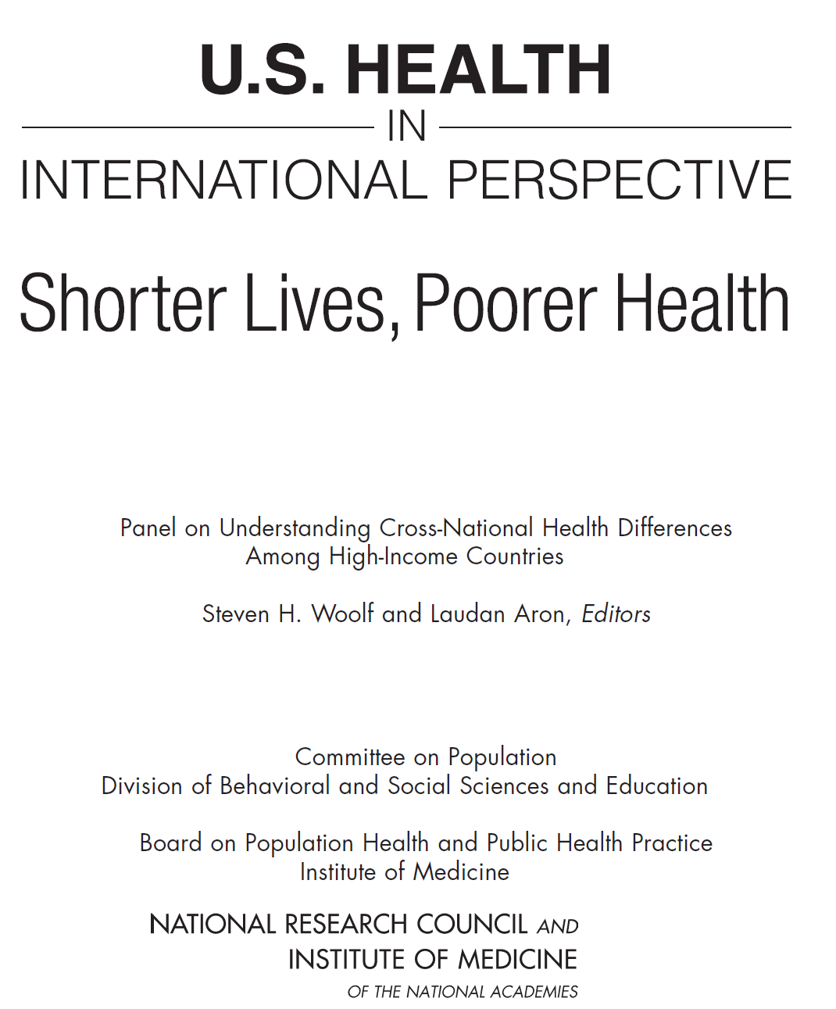
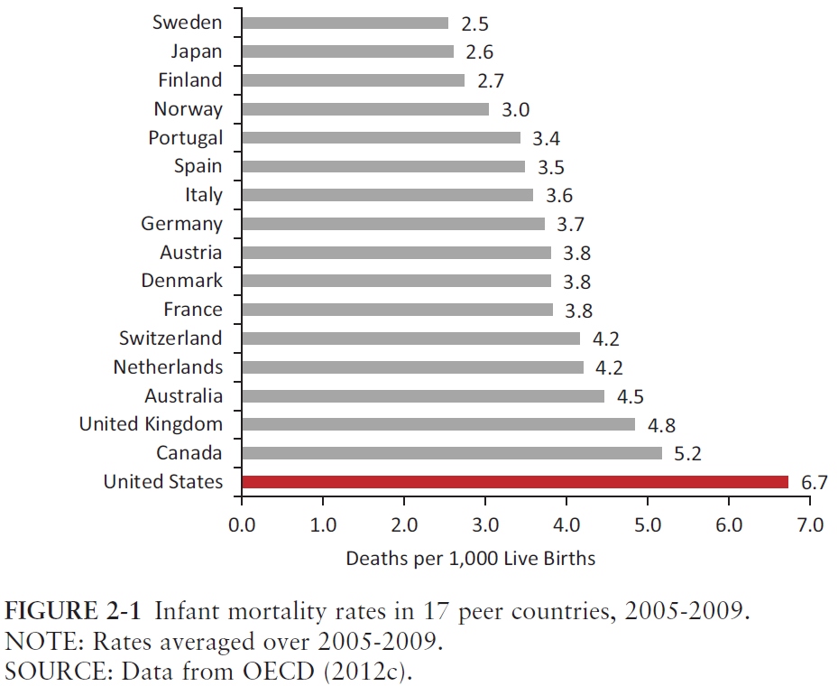
IOM chose 16 peer countries. 13 are same as the one’s we’ve used. They use 3 countries (Denmark, Finland, Switzerland) that have 100,000 births. We include Belgium, Czech Republic, Greece and Hungary
Notes:
The Institute of Medicine published in early 2013 the report described in the slide above. This 405 page study (available free online from National Academies Press website) carefully identifies 15 countries to compare to the US on a wide variety of health measures, including maternal and infant outcomes. It’s a valuable study whose findings can be easily incorporated into classrooms. For purposes of this presentation it helps affirm the choice of the comparison countries presented here. The 3 countries they use that we don’t were excluded here because they had too few births: Denmark ( ~58,000) Finland (~60,000) and Switzerland (~82,000). All 3 by the way have much better birth outcomes than the U.S. The four we include that they don’t are Belgium, Czech Republic, Greece and Hungary. Greece, while it meets our criteria, is often missing from the analysis because of limited data available.

Slide 10
How is the U.S. doing relative to comparison countries?
Neonatal Mortality Rate Infant Deaths in First 27 days X 1,000 _____________ Live Births | Perinatal Mortality Rate Fetal deaths + deaths in the first week X 1,000 _______________ Live births + fetal deaths
BirthByTheNumbers.org
Notes:
For international comparisons, the perinatal mortality rate is preferred because, by including fetal deaths, it helps balance out differences in the ways countries report on live births or fetal deaths. The problem is that perinatal mortality data often can’t be broken down by subgroups because fetal death reporting often does not include demographic characteristics of those who died.

Slide 11
Neonatal Mortality Rates (per 1,000 births), 2010, Industrialized Countries with 100,000+ Births
Source: OECD Health Data 2013 and NCHS, Deaths Final Data for 2007.
BirthByTheNumbers.org
Notes:
NOTE: these are rates per 1,000 live births, not % based on 100. Neonatal deaths is relatively rare in industrialized countries.
In the comparison of the 16 comparable countries we’ve identified, the US ranks last. If we limit the US births to just those to non-Hispanic white mothers, and compare that to the overall figures for other countries, the US would rank 15th out of the 16 countries. The US has wide disparities in infant outcomes between black and whites, but those disparities do not account for the US’ poor showing.

Slide 12
Perinatal Mortality Rates (per 1,000 births), 2010, Industrialized Countries 100,000+ Births

Slide 13
Maternal Mortality Ratios
 | Maternal Mortality Ratio Maternal Deaths all causes X 100,000 _______________ Live births
Notes:
Because maternal deaths are quite rare in industrialized countries, the figures are based per 100,000 births. The standard measure for deaths includes deaths during pregnancy through 42 days after the birth, though other measures use different standards (e.g. pregnancy associated mortality includes deaths up to 1 year after birth).
Maternal mortality is a ratio (rather than a rate as in the earlier measures of infant deaths), because while deaths during pregnancy are included in the numerator, the denominator is based on live births rather than pregnancies because most countries don’t maintain records of pregnancy totals, just births and deaths.

Slide 14
Maternal Mortality Rates, (per 100,000 births), 2010, Industrialized Countries with 200,000+ births
U.S. 2007:
Black non-Hispanic 28.4
White non-Hispanic 10.5
Hispanic 8.9
*2009; #2008; **2007
Maternal Mortality Rate
Sources: OECD Health Data 2013; NCHS. 2009. Deaths, Final Data, 2007.
Notes:
Given maternal mortality rates are reported per 100,000 live births, we limited the examination to the 10 countries in our comparison group with at least 200,000 births annually. The US again ranks 2nd last and even limiting the comparison to non-Hispanic white mothers, the US still would only rank 9th out of the 10. The mortality rate for non-Hispanic black mothers (28/100,000) would put the US in the company of Turkey (23/100,000) , Chile (26), Romania (27) and Iran (30).

Slide 15
Other countries do better because the U.S. is different:
-- more diversity,
-- weaker social support system,
-- inequality in our health care system.
What if we compared subgroups in the U.S. to other countries?
Notes:
This is a common argument – that the US’ diversity is the cause of their poor showing and that the other countries better showing is because they have such a homogeneous population. While this is somewhat true in the case of Japan, in most European countries there has been a major influx of immigrants from developing countries that has resulted in much greater demographic diversity than in the past.
These next 5 slides examine only lower risk subsets of the US birthing population to see how they’d rank against the entire populations of our comparison countries.

Slide 16
US Subgroups in Comparative Context with other Industrialized Countries
US Subgroup | U.S. IMR 2009 | Rank (17 - 100K)
All | 6.4 | 17
Source: U.S. subgroups: Mathews & M. MacDorman. 1/24/13. Infant mortality statistics from the 2009 period linked birth/infant death data set. NVSR v. 61 (8).Hyattsville, MD: NCHS, Table 2. *Other IMRs from OECD Health Data 2013.
Notes:
Infant mortality (deaths up to one year of age per 1,000 live births) is used here because it is the only measure we can do such demographic breakdowns on the US data. Perinatal mortality would be preferable if the data were available, but those rates are not reported by subgroup because of limited reporting on fetal deaths which are included in the measure of perinatal mortality.

Slide 17
US Subgroups in Comparative Context with other Industrialized Countries
US Subgroup | U.S. IMR 2009 | Rank (17 - 100K)
All | 6.4 | 17
White Non-Hispanic | 5.3 | 17
Source: U.S. subgroups: Mathews & M. MacDorman. 1/24/13. Infant mortality statistics from the 2009 period linked birth/infant death data set. NVSR v. 61 (8).Hyattsville, MD: NCHS, Table 2. *Other IMRs from OECD Health Data 2013.
Notes:
Limiting the comparison to only non Hispanic white mothers from the US compared to the entire population of other countries results in a lower rate for the US (5.3 vs 6.4 per thousand), but that is still higher than the other 16 comparison countries’ infant mortality rate.

Slide 18
US Subgroups in Comparative Context with other Industrialized Countries
US Subgroup | U.S. IMR 2009 | Rank (17- 100K)
All | 6.4 | 17
White Non-Hispanic | 5.3 | 17
White NH, Native Born | 5.4 | 17
Source: U.S. subgroups: Mathews & M. MacDorman. 1/24/13. Infant mortality statistics from the 2009 period linked birth/infant death data set. NVSR v. 61 (8).Hyattsville, MD: NCHS, Table 2. *Other IMRs from OECD Health Data 2013.
Notes:
The infant mortality rate for births to white non-Hispanic US born mothers is actually much higher (5.4) than that for births to white non-Hispanic foreign born mothers (3.9), hence no change in rank.

Slide 19
US Subgroups in Comparative Context with other Industrialized Countries
US Subgroup | U.S. IMR 2009 | Rank (17- 100K)
All | 6.4 | 17
White Non-Hispanic | 5.3 | 17
White NH, Native Born | 5.4 | 17
White NH, Singleton Birth | 4.6 | 15
Source: U.S. subgroups: Mathews & M. MacDorman. 1/24/13. Infant mortality statistics from the 2009 period linked birth/infant death data set. NVSR v. 61 (8).Hyattsville, MD: NCHS, Table 2. *Other IMRs from OECD Health Data 2013.
Notes:
Limiting the analysis to singleton births (excluding births of twins, triplets, etc.) further reduces the US rate to 4.6/1,000 and elevates it’s rank to 15th, of the 17 comparison countries.

Slide 20
US Subgroups in Comparative Context with other Industrialized Countries
US Subgroup | U.S. IMR 2009 | Rank (17- 100K)
All | 6.4 | 17
White Non-Hispanic | 5.3 | 17
White NH, Native Born | 5.4 | 17
White NH, Singleton Birth | 4.6 | 15
White NH, 30-34 yrs old | 4.1 | 13
Source: U.S. subgroups: Mathews & M. MacDorman. 1/24/13. Infant mortality statistics from the 2009 period linked birth/infant death data set. NVSR v. 61 (8).Hyattsville, MD: NCHS, Table 2. *Other IMRs from OECD Health Data 2013.
Notes:
Births to mothers 30-34 have the lowest infant mortality rate of any age category for mothers. Limiting the US analysis to non-Hispanic white 30-34 year old mothers lowers the rate further (to 4.1/1,000) and the rank to 13th, when compared with the entire population of the other 16 countries.

Slide 21
US Subgroups in Comparative Context with other Industrialized Countries
US Subgroup | U.S. IMR 2009 | Rank (17- 100K)
All | 6.4 | 17
White Non-Hispanic | 5.3 | 17
White NH, Native Born | 5.4 | 17
White NH, Singleton Birth | 4.6 | 15
White NH, 30-34 yrs old | 4.1 | 13
White NH, 37-41 weeks | 2.3 | 1
Source: U.S. subgroups: Mathews & M. MacDorman. 1/24/13. Infant mortality statistics from the 2009 period linked birth/infant death data set. NVSR v. 61 (8).Hyattsville, MD: NCHS, Table 2. *Other IMRs from OECD Health Data 2013.
Notes:
The infant mortality rate for preterm births (<37 weeks) is much higher (29.9) than the rate for full term births (2.3) and it’s only by limiting the US births to full term births to NH white mothers that we can move the US to the lowest infant mortality rate among the comparison countries. Keep in mind these full term births are compared with the entire population of the other 16 countries.

Slide 22
Examining Trends over Time
Notes:
It may be that looking at contemporary rates obscures trends over time so we’ll look at how the US fares when compared to the average rates since 2000 for the other 15 comparison countries.

Slide 23
Neonatal Mortality Rate (per 1,000 births), 2000-2011, U.S., & Ave. for Industrialized Countries*
U.S.
13% decrease
4.6
4.2
Industrialized Countries
26% decrease
3.1
2.2
* Countries with 100,000+ births (2011): Australia, Belgium, Canada, Czech Republic, France, Germany, Greece, Hungary, Italy, Japan, Netherlands, Portugal, S. Korea, Spain, Sweden, U.K.
Source: OECD Health Data, 2013 & MacDorman MF, et al. Recent declines in infant mortality in the United States, 2005–2011. NCHS data brief, no 120. Hyattsville, MD: NCHS. 2013.
Source: OECD Health Data, 2013
Notes:
In 2000, the US neonatal mortality rate (4.6/1,000) was 48% higher than the average for the other 16 countries (3.1/1,000). Over the next 7 years the US rate stayed largely unchanged and then began declining after 2007 for an overall decrease of 13% from 2000-2011. The comparison countries, even though they started with a much lower rate, experienced a decline of 26% over the decade. The result is that by 2011, the US rate was almost double that of the comparison countries.

Slide 24
Neonatal Mortality Rate (per 1,000 births), 2000-2011, U.S., & Ave. for Industrialized Countries*
U.S.
4.6
4.1
3.1
If the U,S. neonatal mortality rate equaled the current average rate of the other countries in 2011, that would mean almost 6,955 fewer deaths to babies 28 days or younger annually.
2.3
* Countries with 100,000+ births (2009): Australia, Belgium, Canada, Czech Republic, France, Germany, Greece, Hungary, Italy, Japan, Netherlands, Portugal, Spain, S. Korea, Sweden, U.K.
Source: OECD Health Data, 2013 & MacDorman MF, et al. Recent declines in infant mortality in the United States, 2005–2011. NCHS data brief, no 120. Hyattsville, MD: NCHS. 2013.
Notes:
As the box added in the lower left corner notes, putting the rates in concrete terms reveals that if the US could merely match the average of the comparison countries, the result would be 6,955 fewer neonatal deaths every year.

Slide 25
Perinatal Mortality Rates, 2000-2010 , U.S., & Ave. for Industrialized Countries*
* Countries with 100,000+ births (2006): Australia, Belgium, Canada, Czech Republic, France, Germany, Greece, Hungary, Italy, Japan, Netherlands, Portugal, S. Korea, Spain, Sweden, United Kingdom

Slide 26
Maternal Mortality Ratios (per 100,000 births), 2000-2009, U.S. & Ave. Industrialized Countries*
U.S.
30%
Increase
Case
Ascertainment??
Industrialized Countries
3 % Decrease
* Countries with 200,000+ births (2009): Australia, Canada, France, Germany, Italy, Japan, S. Korea , Spain, United Kingdom
Sources: OECD Health Data 2013; NCHS. 2010. Deaths, Final Data, 2007.
Notes:
The comparison here is to countries with at least 200,000 births, given the rarity of maternal deaths.
For some technical reasons that have to do with a 2003 revision to US death certificates that has changed reporting, the U.S. has not reported a rate for maternal mortality since 2007. The WHO has an algorithm they use to estimate maternal mortality and when it’s applied to the U.S. they report an estimated rate of 20/100,000.
The reference to case ascertainment involves a major claim for the US poor standing is that the US has improved its identification of cases of maternal deaths. However, the argument is difficult to sustain when one considers that the other countries the US is being compared to are also improving their case ascertainment as well. It may be that better ascertainment accounts for the relatively flat line for the comparison countries as well as the rise in the US rate.

Slide 27
What about process?
Notes:
Moving past outcomes we can look at how birth is carried out, with particular attention to cesarean birth.

Slide 28
US Cesarean Rates, 1989-2011
1,296,779
%
If the 2011 cesarean rate was the same as in 1996, there would have been 478,000 fewer cesareans in the U.S. in ’11.
Source: National Center for Health Statistics Annual Birth Reports
Notes:
There were 3,953,590 births in the US in 2011. If the 1996 rate of 20.7% had been maintained, there would have been 818,393 cesareans.
In 2010 for the first time in 13 years, the US cesarean rate decreased slightly (from 32.9% to 32.8%). 25 states experienced a decline between 2009 and 2010, led by Delaware (1.9 percentage points), North Dakota (1.6 percentage points), Alaska (1.2 percentage points).
In 2011, the cesarean rate remained level at 32.8%.

Slide 29
Primary Cesarean and VBAC Rates, U.S., 1989-2010
r = -.95
Note: 2005-2010
unofficial
Source: NCHS. Annual Birth Reports & Vital Stats
Notes:
There has been a strong relationship in the culture of interventions. As the rate of VBACs changed in the U.S., the primary cesarean rate changed in an almost perfect negative correlation over time. Increases in one corresponded closely to decreases in the other.

Slide 30
Cesarean Rates in Industrialized Countries* with 100,000+ Births, 2011
*2010
* No data on cesarean rates in Greece
Sources: OECD Health Data 2013; U.S. Natality Data; Japan – sample; Lancet 6736(09)61870-5.
Notes:
The US is in the upper group of country cesarean rates, but not the highest with Italy, Korea, Hungary and Portugal all having higher rates. Most comparison countries have lower rates, most notably the Netherlands, Sweden, Belgium, and Japan – all countries with very different systems.
Cesarean rates have been leveling off in industrialized countries in recent years. This applies to the US as well with cesarean rates of 32.9, 32.8, and 32.8 from 2009-2011.

Slide 31
Total cesarean rates by race/ethnicity, U.S. 1989-2011
1989 WNH
+1.4percentage points
2011 BNH
+3.1 percentage points
Source: National Center for Health Statistics Annual Birth Reports
Notes:
This slide breaks down cesarean rates by race/ethnicity into the three major groups reported on by NCHS (data on births to Asian Mothers is not readily available nationally though it is in many states). It undermines the myth that the rising cesarean rate was driven by white mothers, perhaps demanding scheduled cesareans.
Actually there’s a more interesting pattern with the decline in cesarean rates in the early 1990s happening only among white non-Hispanic and Hispanic mothers. Rates for black non-Hispanic mothers were essentially unchanged from 1990-1997. When rates began to rise in the mid 1990s, they rose slightly faster among black mothers than the other groups. The result is that over the 20 year period documented, the US went from white non-Hispanic mothers having a cesarean rate 1.4 percentage points higher than black non-Hispanic mothers to the latter group having a rate 2.9 percentage points higher by 2010.
Notably the overall slight decline in U.S. cesarean rates between 2009-2010 (32.9% to 32.8%) occurred only among white mothers. Rates for Hispanic and black non-Hispanic mothers continued to rise slightly between 2009-2010.

Slide 32
Total Cesarean Rates (per 100 births) by Age of Mother: United States, 1996 and 2011
Overall increase, 1996-2010: 58.5%
Percent
Source: National vital statistics system, NCHS, CDC.
Notes:
The argument is frequently made that the rising age of mothers in the US is a major cause for the increase in cesarean rates. There are two problems with this argument:
(1) The average age of mothers in the US stopped increasing back in 2003 and the cesarean rate continued to grow as rapidly after that date as before; and
(2) As this graph shows, aside from a surge in rates for 20-24 year olds, the overall increase in rates by age is comparable across every age group and hardly concentrated among older mothers. In fact rates are increasing at a faster clip among younger mothers which, given the difficulty of getting a VBAC, means increasing pressure for more cesareans when these mothers have other children.

Slide 33
VBAC Rates*, U.S.,1990-2010
NOTE: Rates for 2005-2010 are unofficial
* Number of VBACs among women with prior cesarean
Source: NCHS Vital Stats. http://www.cdc.gov/nchs/VitalStats.htm
Notes:
The rate of vaginal birth after cesarean (VBAC) is based on the number of vaginal births among women who had a prior cesarean. VBACs rose substantially in the early 1990s to a peak of 28% as part of a national effort to increase these opportunities for mothers at low risk who wished to avoid a repeat cesarean. There was a strong push back against VBACs by some leading obstetricians based on some studies but perhaps more importantly in key editorials in major journals and rates began to drop after 1996. By 2005 the rates were down to 8% and have remained steady at that rate since.
The reason that the rates reported here for 2005-2009 are unofficial is that NCHS has stopped reporting a national VBAC rate because states have slightly different reporting systems based on an improved birth certificate measure that not all states have yet adopted. Nonetheless one can reasonably estimate a national rate (if anything this estimate may be slightly lower than the “actual” rate) using national data and that’s what we present here.

Slide 34
VBAC Rates, Selected Countries, 2004
Source: Adapted from Peristats, US & Canadian Data
Notes:
The US ranks last when compared to other industrialized countries on VBAC rates. Other countries don’t regularly report VBAC rates but a collaboration of European countries put together a report entitled Euro-Peristats (http://www.europeristat.com/) that provides data that can be used to estimate VBAC rates. Their most recent publication involved data from 2004, hence that was our point of comparison.

Slide 35
Do High Rates of Intervention Matter?
1. Outcomes (NMR & GA)
2. Costs
Notes:
What’s the problem with high rates of intervention? Interventions in and of themselves can be critical to the saving of maternal and infant lives. The question is whether there is a point at which interventions that are helpful for high risk cases, become so widely applied to the general population that they create problems where they wouldn’t otherwise have existed.

Slide 36
Gestational Age, U.S. All Births, 1990, 2011
* Only births occurring at home.
Source: Martin JA, Hamilton BE, Ventura SJ, Osterman MJK, and Mathews TJ. Births: Final data for 2011. National vital statistics reports; vol 62 no 1. Hyattsville, MD: National Center for Health Statistics. 2013.
Notes:
One of the most notable changes in birth in the US has been the shift in gestational age in the past two decades. The average gestational age has shifted by a week from a peak of 40 weeks in 1990 to a very clear peak of 39 weeks in 2011.
At 34-36 weeks, 37--38 and 39 weeks there were a larger proportion of births in 2011 than 1990, while at 40, 41 and 42+ weeks, there were fewer births in 2011 than 1990.

Slide 37
Cesarean Rates and
Neonatal Mortality
Low Income
Medium Income
High Income
Source: Althabe F.Cesarean Section Rates and Maternal & Neonatal Mortality Birth.2006;33:270
Notes:
This is a fascinating study published in 2006 in the journal Birth. The authors examined neonatal mortality rates and cesarean rates in a wide range of countries. When they stratified those countries by income levels in the countries they found that:
For low income countries, higher cesarean rates were related to lower neonatal mortality rates, perhaps reflecting the limited maternity care infrastructure in those countries and the need for more resources to address the many high risk births in those settings
For middle income countries there was virtually no relationship between cesarean rates and neonatal mortality
For high income countries, there was a slightly positive relationship with higher cesarean rates associated with higher neonatal mortality rates, though the relationship did not reach statistical significance.

Slide 38
Percent of singleton preterm (<37 weeks) births by method of delivery, United States, 1991-2006
11.0%
9.7%
6.7%
5.7%
Note: Births with method of delivery and induction of labor not stated are excluded.
Source: MacDorman et al. AJPH, 2011.
Notes:
A study by MacDorman and colleagues examined the method of delivery in premature births and found the following. For spontaneous vaginal births (i.e. not induced and not cesareans), the rate of prematurity actually went down between 1991-2006. The increase in prematurity was based on births in which there was a vaginal birth following induction, cesarean following induction or cesarean without induction.
Three points to keep in mind: (1) this figure examines only singleton births (births of twins or other multiples are more likely to be premature); (2) many (but probably not all) of these inductions or cesareans were medically necessary; and (3) the overall prematurity rate began to decline after 2006 dropping from 12.8% (remember overall figure includes multiples) in 2006 to 11.99% in 2010.

Slide 39
National Costs and Hospitalizations

Slide 40
LEADING MAJOR DIAGNOSTIC CATEGORIES by NUMBER OF HOSPITAL DISCHARGES, U.S., 2009
AHRQ. 2011. HCUPnet, Healthcare Cost & Utilization Project. Rockville, MD: AHRQ. http://hcupnet.ahrq.gov. Accessed 7/16/2011.
Notes:
This data is simply a reminder that childbirth is a major driver of US health care services with the 2nd and 3rd leading reasons for hospitalizations in the US in 2009.

Slide 41
MEDIAN FACILITY LABOR & BIRTH CHARGES BY SITE & MODE OF BIRTH, U.S., 2010
NOTE: Hospital charges; no physician costs
Charge in 2010
$17,688
Increase in Charge in 2000-2010
$14,938
Charge in 2000
$10,234
$8,570
  Sources: AHRQ. 2010. HCUPnet, Healthcare Cost & Utilization Project. Rockville, MD: AHRQ. http://hcupnet.ahrq.gov. Accessed 4/12/13;
Notes:
Using the same source for hospital discharge data as in the previous slide, this presents hospital charges (which are not the same as what it costs hospitals for these services) for births by method of delivery. Medians are used to avoid the impact of a limited number of very large charges. There’s a couple of points to keep in mind concerning these data:
they are best used for comparison across methods of delivery since the basis for calculating charges is the same in all 4 cases above; and
these do not include physician charges for services in these cases.

Slide 42
Estimated Total Charges, Hospital Birth, U.S., 1993-2010 (000,000)
$ 51,031
$ 14,039
  Sources: AHRQ. 2009. HCUPnet, Healthcare Cost & Utilization Project. Rockville, MD: AHRQ. http://hcupnet.ahrq.gov. Accessed 4/16/13.
Notes:
Note that this charts millions of dollars so the $50,942 refers to more than 50 billion dollars in total hospital charges for birth related services. Once again this does not account for physician charges. Total charges increased by 263% between 1993-2009, while the total number of births increased by 3.3% (4,000,240 to 4,130,665 ) over the same period.

Slide 43
Have maternal request cesareans played a major role in these increases?
Notes:
One of the reasons commonly cited for the rising cesarean rate is that mothers are requesting cesareans. In a 2006 national survey we included specific questions to explore that issue.

Slide 44


Asking Mothers about
Maternal Request Cesareans
http://www.childbirthconnection.org
Notes:
Listening to Mothers 2 was a national survey of 1573 mothers in early 2006 asking them about their childbirth experiences in 2005. The full report and questionnaire are available from the website noted on the slide.

Slide 45
Two Components to Maternal Request Primary Cesarean
1. Mother made request for planned cesarean before labor
Notes:
We focused on primary cesareans because the issue of maternal request for a repeat cesarean was largely moot because at the time of the survey it was almost impossible for a women not to have a repeat cesarean (91% with a prior cesarean did) so the question of her wishes didn’t really matter.
We used 2 criteria to identify a maternal request primary cesarean. :
The mother requested the cesarean before she went into labor – asking for a cesarean in the middle of transition is not what people generally meant by maternal choice);
The cesarean was not for a medical indication (the discussion around maternal request focused on freedom of choice, not response to a medical condition)

Slide 46
Two Components to Maternal Request Primary Cesarean
1. Mother made request for planned cesarean before labor
2. Cesarean for no medical reason

Slide 47
Patient Choice Primary Cesareans
Combining reason for cesarean and timing of decision found only about 1% of respondents had a planned primary cesarean for no medical reason.
“I think that [cesarean] is… the best way … to give birth. It is a planned way, no hassle, no pain, the baby doesn’t struggle to come out, the baby is not pressed to come out …I think that … everybody should have the baby by cesarean section.” (quote from LtM2)
Studies from England and Canada confirm very low rates of maternal request cesareans
Notes:
Of those women in Listening to Mothers 3 who had a primary cesarean, only 4% responded that they had a cesarean for no medical reason. Only 10% indicated that she made the decision for a cesarean before labor began. Combining those two categories resulted in only 1% of mothers with a primary cesarean meeting the criteria for a maternal request cesarean. The quote indicates she truly had a maternal request cesarean in the sense it has been discussed in the media, but the rate (1%) can hardly account for the more than 50% increase in cesareans in the US.
Similar studies using data from the Canadian Maternity Experiences Survey and from England in their Recorded Delivery study had similar findings.

Slide 48
Pressure to Accept Interventions by Method of Delivery
Did you feel pressure from any health professional to have a cesarean? % yes
Source: Declercq et al. 2013. Listening to Mothers III.
BirthByTheNumbers.org
Notes:
This question examined the reverse of the “maternal request” issue – did mothers feel pressure to accept an intervention. While overall only 13% of mothers indicated feeling pressured to have a cesarean (up from 9% in 2006), when we broke that down by method of delivery, you see an interesting pattern with about a quarter of those mothers who had a cesarean saying they felt pressured to have it. Perhaps more interesting is the finding that more than a quarter of mothers who had a VBAC felt pressured to have a repeat cesarean.
This finding turns the popular discussion on its head – rather than mothers pressuring physicians to have cesareans, when we asked mothers – they were the ones feeling pressured to have a cesarean.

Slide 49
Have maternal request cesareans played a major role in these increases?
NO!
So what is the reason for the increasing cesarean rate?

Slide 50
Have maternal request cesareans played a major role in these increases?
NO!
So what is the reason for the increasing cesarean rate?
Practice Changes

Slide 51
Cesarean Rates, Low Risk*, First-Time Mothers for Medical Risk Factors & Labor Complications
*Singleton, Vertex, Full Gestation Births
Notes:
These are the cesarean rates associated with these conditions in 1991. We don’t know if the cesarean was done because of the condition, only that the birth certificate recorded both the condition and a cesarean.

Slide 52
Revisiting the trend in cesareans
in the US for comparison
1,296,779
%
BirthByTheNumbers.org
Source: National Center for Health Statistics Annual Birth Reports

Slide 53
Cesarean Rates, Low Risk*, First-Time Mothers for Medical Risk Factors & Labor Complications
*Singleton, Vertex, Full Gestation Births
BirthByTheNumbers.org
Notes:
Note that cesarean rates associated with every one of the conditions declined during the early 1990s. In a related study, Declercq et al (American Journal of Public Health 2006 May;96[5]:867-72) found no changes in the rates of these conditions over time.

Slide 54
Cesarean Rates, Low Risk*, First-Time Mothers for Medical Risk Factors & Labor Complications
Source: CDC Vital Stats. http://www.cdc.gov/nchs/VitalStats.htm
*Singleton, Vertex, Full Gestation Births
BirthByTheNumbers.org
Notes:
These general patterns suggest that the changes in cesarean rates are less a function of changing medical risk profiles of women and more the result of changes in the nature of practice in responding to these different conditions.
On a technical note, because of changes in the birth certificate measures, the 2009 data is not exactly comparable to the 1991 & 1996 data either because a measure was slightly changed or because not all states had adopted the revised measure. However, using 2005 data (as in the original video) when the measures were comparable reveals the same patterns.

Slide 55
Women have not changed nearly as much as practice patterns have
BirthByTheNumbers.org
Notes:
The title of this article captures effectively the point hopefully made by the previous slides.

Slide 56
Other Cool Slides that Might be Useful in Class
BirthByTheNumbers.org

Slide 57
Cascade of intervention in first-time mothers who experienced labor
Base: first-time mothers with full term births who experienced labor n=821
First-time mothers who experienced labor
Induction No
53%
Induction Yes
47%
Epidural No
39%
Epidural Yes
61%
Epidural No
22%
Epidural Yes
78%
Cesarean
Yes
5%
Cesarean
Yes
20%
Cesarean
Yes
19%
Cesarean
Yes
31%
Note: in this group, which included 93% of first-time mothers, the overall epidural rate was 71% and overall cesarean rate was 19%
BirthByTheNumbers.org
Notes:
This figure is from Listening to Mothers 3 and in a crude sense illustrates the tendency of one intervention to lead to another – mothers with an induction were more likely to have an epidural (78%) than those without an induction (61%). Mothers with both an induction and epidural (31%) were far more likely to have a cesarean than those without either (5%).

Slide 58
Inductions in Vaginal Births, U.S., 1990-2010
Source: Centers for Disease Control and Prevention. National Center for Health Statistics. VitalStats. http://www.cdc.gov/nchs/vitalstats.htm.
BirthByTheNumbers.org
Notes:
Simply the annual rate of inductions from US birth certificate data. When compared to other studies, this undercounts the actual totals and the data may be most useful to display a trend in increased induction use.

Slide 59
BirthByTheNumbers.org
Notes:
Rates by state for 2010. For a more complete look at these trends by state, see the state maps over time also available on this website.

Slide 60
Total U.S. Births, 1990-2011
BirthByTheNumbers.org
Notes:
Shifts in the number of U.S. births over time noting the sizable recent decline in total births.

Slide 61
U.S. Fertility Rates (per 1,000) by Race/Ethnicity, 1989-2011
Fertility rates computed by relating total births, regardless of age of mother, to women 15-44 years.
BirthByTheNumbers.org
Notes:
To help explain the drop in the total number of births, here are the fertility rates by large race/ethnicity subgroups displaying the substantial decline among Hispanic mothers.

Slide 62
Proportion of Births to Older Mothers, U.S. 1990-2011
>30
NOTE: Since 2003
Cesarean Rate
Increased by 20%
> 35
> 35
BirthByTheNumbers.org
Notes:
For those arguing that the rising age of US mothers is driving higher cesarean rates, this notes that the rates have been relatively flat from 2003-2009 when the cesarean arte was rising rapidly.

Slide 63
Are Babies Getting Bigger?
% Singleton Babies by Birthweight, U. S.,
1991-2010
41%
41%
39%
36%
35%
BirthByTheNumbers.org
Notes:
It’s also argued that an increasing cesarean rate is driven by the increasing number of larger babies – a powerful point except that it’s not true. This presents the distribution of birthweights over time and we find that the proportion of large and very large babies has gone down in recent years. This is not a function of more multiple births (twins etc.) since this figure is limited to singleton births.

Slide 64
Rates of Multiple Births (proportion of all babies in multiple births), U.S., 1980-2011
BirthByTheNumbers.org
Notes:
The rate of multiple births has also leveled off in recent years – again not providing much explanation for a rising cesarean rate.

Slide 65
Percentage of Live Births Attended by Certified Nurse Midwive’s, U.S. 1989 - 2011
Source: National Center for Health Statistics, Final Data Births, annual reports,1989-2011
Notes:
65
This figure charts the trends in midwife attended deliveries over the past 23 years. The rise of cesareans has reduced somewhat the opportunities for cnm deliveries.

Slide 66
For more information and additional resources regularly check:
BirthByTheNumbers.org
The site is updated as additional data becomes available.
BirthByTheNumbers.org

